Slide 1
Digital Marketing & Its Effects On The Business With Reference to Branex.
A Project Submitted to
University of Mumbai for partial completion of the degree of Bachelor of
Management Studies Under the Faculty of Commerce
By
Harshal Prakash Deshmukh
Under the Guidance of PROF. SUMIT MHATRE
SPECIALIZATION
MARKETING
PILLAI HOC COLLEGE OF ARTS ,SCIENCE AND COMMERCE,RASAYNI
Jan 2022

Slide 2
Digital Marketing & Its Effects On The Business With Reference to Branex.
A Project Submitted to
University of Mumbai for partial completion of the degree of Bachelor of Management Studies
Under the Faculty of Commerce
By
Harshal Prakash Deshmukh
Under the Guidance of PROF. SUMIT MHATRE
SPECIALIZATION
MARKETING
PILLAI HOC COLLEGE OF ARTS ,SCIENCE AND COMMERCE,RASAYNI
Jan 2022

Slide 3
INDEX
SR. NO. | NAME OF THE TOPIC | PAGE NO.
1 | Executive Summary | 6
2 | Introduction | 7
3 | Research Methodology | 12
4 | Data Collection | 13
5 | Company Profile | 18
6 | Industry Analysis | 23
7 | Literature Review | 28
8 | Digital Marketing | 31
9 | Digital Marketing Channels | 33
10 | AIDMA as AISAS in Digital Era | 47
11 | Digital Marketing impact on Revenue Generation | 49
12 | Research Prolems | 50
13 | Findings | 51
14 | Learnings | 58
15 | Conclusion | 59
16 | Biliography | 60

Slide 4

Certificate
This is to certify that Mr. HARSHAL PRAKASH DESHMUKH has worked & duly completed his Project Work for the degree of Bachelor of Management Studies under the Faculty of Commerce in the subject of Marketing and his project is entitled, “Digital Marketing & It’s Effects on Business with reference to Branex” under my supervision.
I further certify that the entire work has been done by the learner under my guidance & that no part of it has been submitted previously for any Degree or Diploma of any University.
It is his own work & facts reported by his personal findings & investigations.
Seal of the College
Name & Signature of Guiding Teacher
Date of Submission :

Slide 5
Declaration by learner
I the undersigned MR. HARSHAL PRAKASH DESHMUKH here by, declare that the work embodied in this project work titled “ DIGITAL MARKETING & IT’S EFFECTS ON BUSINESS WITH REFERENCE TO BRANEX”, forms my own contribution to the research work carried out under the guidance of
PROF. SUMEET MHATRE is a result of my own research work and has not been previously submitted to any other University for any other Degree/ Diploma to this or any other University.
Wherever reference has been made to previous works of others, it has been clearly indicated as such and included in the bibliography.
I, here by further declare that all information of this document has been obtained and presented in accordance with academic rules and ethical conduct.
Harshal Deshmukh
Certified by
PROF. Sumeet Mhatre

Slide 6
ACKNOWLEDGEMENT
To list who all have helped me is difficult because they are so numerous and the depth is so enormous.
I would like to acknowledge the following as being idealistic channels and fresh dimensions in the completion of this project.
I take this opportunity to thank the University of Mumbai for giving me chance to do this project.
I would like to thank my Principal, Lata Kasturi Menon for providing the necessary facilities required for completion of this project.
I take this opportunity to thank our coordinator Prof. Sumeet Mhatre, for his moral support and guidance.
I would also like to express my sincere gratitude towards my Project Guide Prof. Sumeet Mhatre whose guidance and care made the project successful.
I would like o thank my College Library, for having provided various reference books and magazines related to my project.
Lastly, I would like to thank each and every person who directly or indirectly helped me in the completion of the project especially my Parents and Peers who supported me throughout my project.

Slide 7
1.EXECUTIVE SUMMARY
Project title: -
“Digital Marketing & its effects on the Business with reference to Branex.”
Digital marketing is marketing that makes use of electronic devices (computers) such as personal computers, smartphones, cell phones, tablets and game consoles to engage with stakeholders. Digital marketing applies technologies or platforms such as websites, e-mail, apps (classic and mobile) and social networks.
Branex consultancy solutions PvtLtd has emerged as one of the best online media companies in the American marketplace. The company offers a plethora of services in all online media platforms. The offerings include marketing and consulting on Facebook, Twitter, LinkedIn, SlideShare, YouTube, and Google. Though the company was started only two years ago, it is way ahead of most of competitors through its relentless pursuit of perfection and enormous amount of creativity which they put in their work. The firm worked with multiple brands on social media and currently have 4 out of Top 30 brands in Facebook USA.
The project was in the marketing department of Branex. The project was “A study on digital marketing and its impact on revenue generation with reference to Branex”. This report will help to get an idea about digital marketing and how the digital marketing has impact on revenue generation for digital marketing companies and with reference to Branex. Through this study we will see how online media companies emerging how they are generating revenue and how they are growing economically and revenue generation models of online media companies particularly reference to Branex.
Main findings of this project are given here. American customers are highly information seekers. They collect more information about a product before buying it. Internet penetration in USA is key player for this phenomenon. Most of Americans are getting stimulus through advertisements, but they are not reaching to end phase of customers purchase journey, mainly in high involvement purchases. Brands are getting more touch point to reach their target group in this digital era. More details about findings are given this report.

Slide 8
2. INTRODUCTION
To begin with, as a part of the curriculum a summer research programme was to be conducted for a period of two months. Given a choice one was allowed to choose the field in which he/she was interested. As my interest and curiosity was in online or digital marketing I choose to work with a start-up company named Branex, I choose the start-up company because with start I can explore myself and why digital marketing? Because it is booming industry, the growth of digital marketing is tremendous and expected to grow more. Due to this summer research, I learnt every aspect of digital marketing include (business development process, content writing, social media) Marketing practices have dramatically shifted with the rise of social media and proliferation of devices, platforms, and applications. Your prospective and current customers are trying to communicate with you, and you can listen and respond faster, and with more personalization than ever before. This shifting environment presents new opportunities and challenges for marketers. With digital marketing, it's easy to fall behind. Digital marketing equips you with the tools you need to assess your organization’s social media and digital marketing strategy and helps you identify areas of improvement. Useful for individuals from small- to medium-sized businesses who want to use new media as a vehicle for growth.Organizations are leveraging digital marketing methods for successful marketing strategy implementation inbound marketing through publishing content online in the form of portals, podcasts, e- journals, online campaigns, social media marketing, search services; and outbound marketing including email marketing, RSS (Really Simple Syndication) feeds and others. A recent survey of 3300 business executives from various industries indicates that on an average, 34% of a company’s leads come from inbound marketing verses 22% through1 outbound marketing .
2.1 Digital Marketing:-
Digital marketing can be defined as the process of promoting of brands using digital distribution channels comprising internet, mobile and other interactive channels. The basic advantage in this form of advertising lies in its low cost model.
Digital Marketing can be classified into Pull and Push marketing.
Pull
Pull digital marketing technologies involve the user having to seek out and directly grab (or pull) the content via web searches. Web site/blogs and streaming media (audio and video) are good examples of this. In each of these examples, users have a specific link (URL) to view the content.
Push
Push digital marketing technologies involve both the marketer (creator of the message) as well as the recipients (the user). Email, SMS,RSS are examples of push digital marketing. In each of these examples, the marketer has to send (push) the messages to the users (subscribers) in order for the message to be received.

Slide 9
Web Site Designing
From the initial process of taking inputs from clients, planning on the basis of such inputs to final implementation and testing all are done using latest web designing techniques and skills. Our services have the advantage of offering clarity in its design style, which is backed up with an easy and free flowing content and latest technical know-how. Not only we provide affordable web site design and ecommerce web development services but also search engine friendly designs. Our Service Includes
Website Design
Website Redesign
Shopping Cart Web Design
Detailed and Advanced Page Layout
Custom Logo Design
Banner Ads
Custom Graphics Design using advanced design tools.
Digital Marketing Trends:
Organizations are implementing a wide range of digital channels so as to engage customers in a more personalized way. Digital marketing trends that organizations are rapidly embracing include
Mobility:
Business Insider's recent report indicates that globally, one in every five people owns a smart phone, and one in every 17 owns a tablet. That's an increase of nearly 1.3 billion smartphones in last four years. Therefore an increased user base accessing the internet via smartphones has prompted many companies to optimize their online content for mobile devices.
Social Media:
Organizations are focusing on engaging with customers through social media to offer real-time interactions. Social media helps organizations reach out to a vast pool of potential customers by supplying them with medical and campaign-related information.
Social-Local-Mobile Marketing:
The growing popularity of smart mobile devices, increasing location based social activities like experience sharing, review reading via social media and the evolution of Global Positioning System (GPS) are helping companies leverage Social-Local-Mobile marketing activities.
Personalized Content Marketing:
Customer engagement, acquisition and retention have all taken on a new dimension with the delivery of unique, personalized, and relevant messages through identified digital channels.Email is one of the most preferred marketing channel to broadcast targeted organization messages and campaigns to existing and prospective customers.

Slide 10
2.2.5 Advanced Analytics:
Increased adoption of digital channels is generating large volumes of customer behavioural data. Advanced actionable analytics can help organizations define targeted marketing strategies.
Search Engine Marketing (SEM) / Search Engine Optimization (SEO) Organizations are focusing on SEO efforts and paid search advertising for enhancing the visibility of their products and services.
One more trend that has been observed recently is the continually mounting costs of pay-per-click (PPC) that
has resulted in the increased disappointment with this form of search engine Advertising. According to experts, the reason behind such high costs is the huge investments made by large business concerns. Consequently, online business owners have now turned to the organic search results delivered through search engine optimization to enjoy so many advantages. There is currently more emphasis given to user- generated content, improved conversion rates, location- or language specific campaigns, and E-mail newsletters.
The future of online Advertising is going to be more interactive with elevated bandwidth and computing speed. Viewing and transmitting videos will be a cakewalk for web surfers. There is also every possibility of witnessing browser-specific results in the coming days. Social media will consolidate their dominance further. They will not only make more revenues, but will grab the attention of more and more users as well. As far as search engine optimization is concerned, the search engine algorithms and link determination factors will be complicated.
Further, thereby giving a hard time to online Advertising companies. Websites will be a lot slimmer to enhance user browsing experience. Last but not least, video search will grow in prominence with the potentiality to dictate the terms in the world of Internet advertising.

Slide 11
TITLE:
A Study on digital marketing and its impact on revenue generation, with reference to Branex
NEED OF THE STUDY:
Advertising is normally done by a third party known as advertising agency.An advertising agency is a service based business dedicated to creating, planning, and handling advertising for its clients. An ad agency is independent from the client and provides an outside point of view to the effort of selling the client's products or services. An agency can also handle overall marketing and sales promotions for its clients. Types of ad agencies are
Full service agencies
Creative agencies
Specialized agencies
In-house agencies
Digital agencies or new media agencies
This report is completely discussing about digital or new media agencies. There was a time when Television was the most popular medium for Marketer to promote, spread awareness and generate leads for their products but now the trend has changed and Digital media has taken its place. Main reason for this change was
Traditional methods are expensive. Compared to digital marketing channels, you could end up
spending lakhs of rupees more.
Traditional marketing channels fail to provide instant feedback and reports about who saw or heard an ad, and took action. This data is collected long after the initial ad impression is made (and still then, the statistics are far from exact numbers).
Digital marketing, on the other hand, refers to marketing methods that allow organizations to see how a campaign is performing in real-time, such as what is being viewed, how often, how long, as well as other statistics such as sales conversions.
The digital landscape is moving at a lightning fast pace. Every industry has been affected by the advances in digital. Digital marketing is an essential part of this for companies who want to utilise the power of the internet in order to boost business. The tremendous scope of Internet Marketing in USA, we have to understand that marketing through the internet can be an entirely different ball game. In fact it is a potent combination of technology and marketing acumen.
Digital Marketing like traditional form of marketing is a highly result driven and set objective practice. One can’t begin a digital marketing campaign without setting the campaign objectives. A digital marketer understands the needs of the clients and visualizes their needs to deliver what they want.
Taking a look at last year’s figures, let’s see what AdAge discovered when looking at the statistics:
77% of people interact with brands on Facebook by looking at posts 17% share news and experiences with others about the brand 13% post updates about brands they have connected with
56% said they would recommend a brand after becoming a fan on Facebook

Slide 12
34% of digital marketers have generated leads from Twitter
so as a marketing management student it's very essential to research on such an important marketing tool and study on its impact on revenue generation will help you to know about how marketing agencies performing .
Scope of the project:
To understand the digital marketing models.
To understand marketing effectiveness.
To understand how digital marketing campaign's takes place.
To understand how digital marketing agencies works and generating revenue.
To understand how digital marketing has impact on revenue generation.
Limitations of this project:
The time span for the project is limited.
This revenue generation model completely with reference to Branex
Time of campaigns for some client is more than three months.
Advertising expenditure of some companies is confidential so it can’t be revealed
2.4 Hypothesis
.Digital marketing is marketing that makes use of electronic devices (computers) such as personal computers, smartphones, cell phones, tablets and game consoles to engage with stakeholder
.Digital Marketing (also Online Marketing, Internet Marketing or Web Marketing) is a collective name for marketing activity carried out online, as opposed to traditional marketing through print media, live promotions, tv and radio advertisement.

Slide 13
3. RESEARCH METHODOLOGY
This report is completely discussing about digital or new media agencies. There was a time when Television was the most popular medium for Marketer to promote, spread awareness and generate leads for their products but now the trend has changed and Digital media has taken its place. Main reason for this change was
Traditional methods are expensive. Compared to digital marketing channels, you could end up
spending lakhs of rupees more.
Traditional marketing channels fail to provide instant feedback and reports about who saw or heard an ad, and took action. This data is collected long after the initial ad impression is made (and still then, the statistics are far from exact numbers).
Digital marketing, on the other hand, refers to marketing methods that allow organizations to see how a campaign is performing in real-time, such as what is being viewed, how often, how long, as well as other statistics such as sales conversions.
Data collection:
The task of data collection begins after a research problem has been defined and research design has been chalked out.
While deciding about the method of data collection to be used for the study, the research should keep in mind two types of data viz. Primary and Secondary.
Sources of data
Primary Data.
Secondary Data.
Primary data:
The observation method is the most commonly used method. Data pertaining to digital marketing process and most of information is collected from project guide in the company. Questionnaire method is also very
widely used in order to give a structure to the entire study.
Secondary data:
Secondary data is collected from already existing sources in various organization broachers & records.
Secondary data for the study were collected from the magazines, websites & other previous studies. To meet the objectives, the study used qualitative research. The descriptive study was done through review of existing literature that helped in validation and extraction of the important variables and factors. Data was collected from secondary sources. Secondary sources were magazines, websites, books, office executives, and company data.

Slide 14
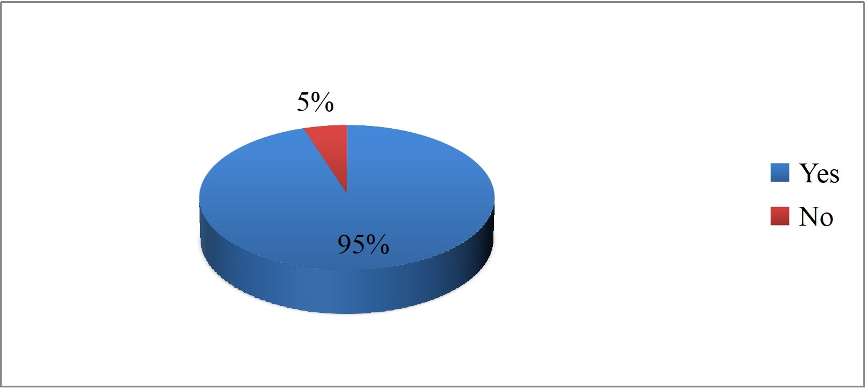
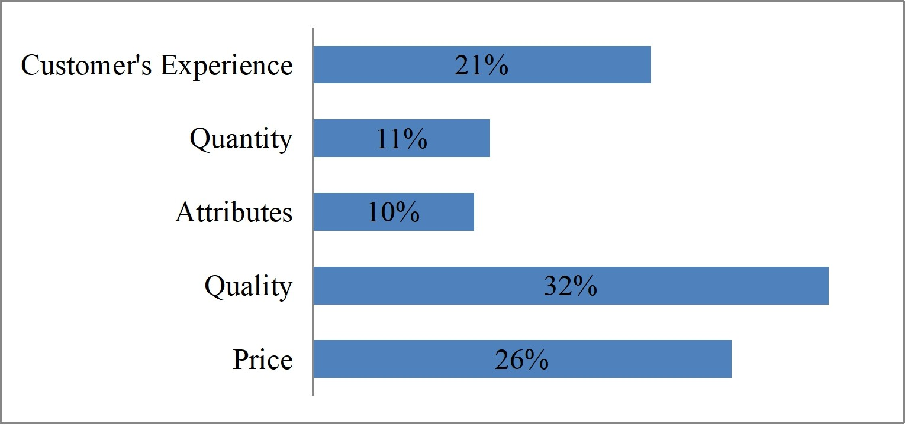
4. Data Collection
1. Do you Collect information before purchasing the products?
Responses | Response for 'Yes' | Response for 'No'
50 | 45 | 5
Survey results showing that 95% of people collect information before purchasing the products. Only few people don’t bother about info before purchasing product.
2. What type of information will you collect?
Responses | Response for 'Customer Experience' | Response for 'Quantity' | Response for 'Attributes' | Response for 'Quality' | Response for 'Price'
50 | 11 | 5 | 5 | 16 | 13
Survey results showing that people who said they collect information before purchasing product they mainly concern about the product quality and price least concern about attributes.

Slide 15
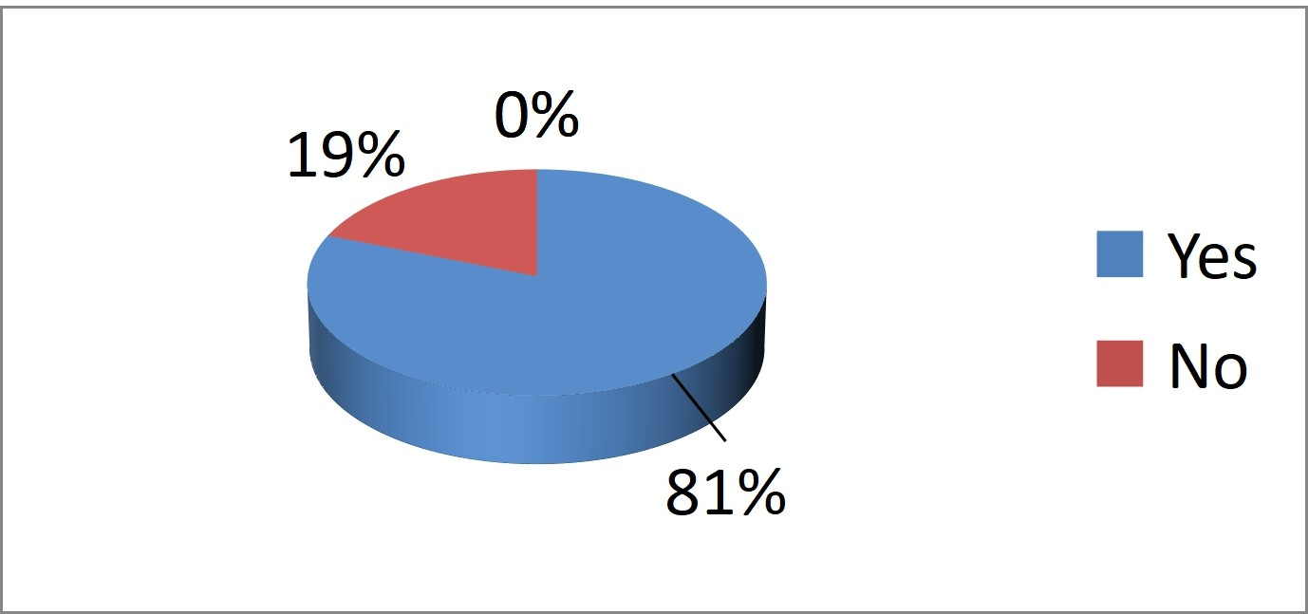
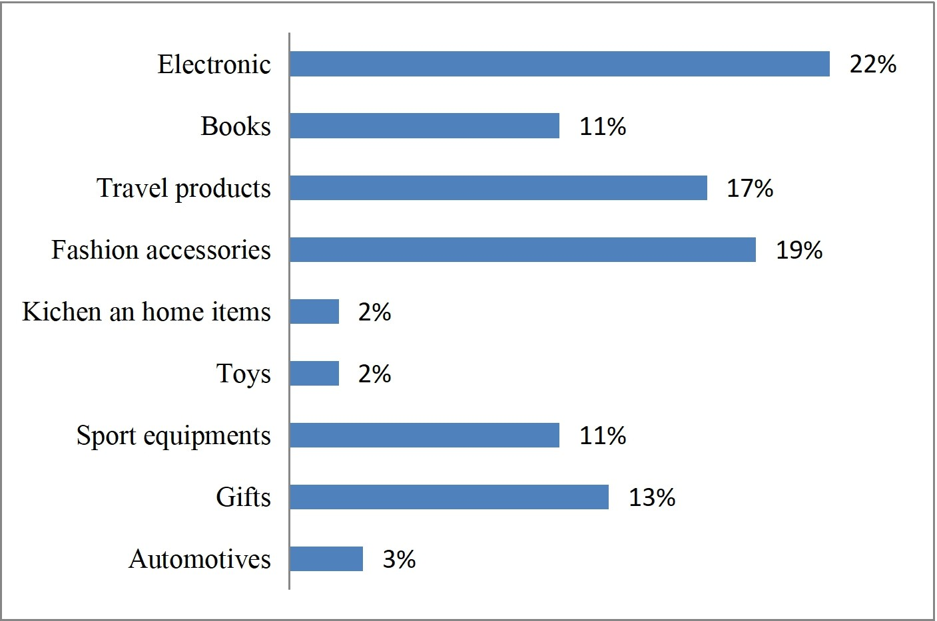
3. Did you ever purchase from an online site?
Responses | Response for 'Yes' | Response for 'No'
50 | 40 | 10
Question asked to most of young people and 81% people said they buy from online site and only few people said they never purchased from online because of reliability issues.
4. If yes, then what type of product / services did you purchase online?
Responses
Response for 'Electronic'
Response for 'Books'
Response for 'Travel Products'
Response for 'Fashion
Response for 'Kitchen/Home
 |  |  |  |  |  |  |  | Accessories' | Items'
50 |  | 12 |  | 6 |  | 9 |  | 9 | 1
Response for 'Toys' 1 |  | Response for 'Sport Equipements' 5 |  | Response for 'Gifts' 6 |  | Response for 1
'Gifts'

Slide 16
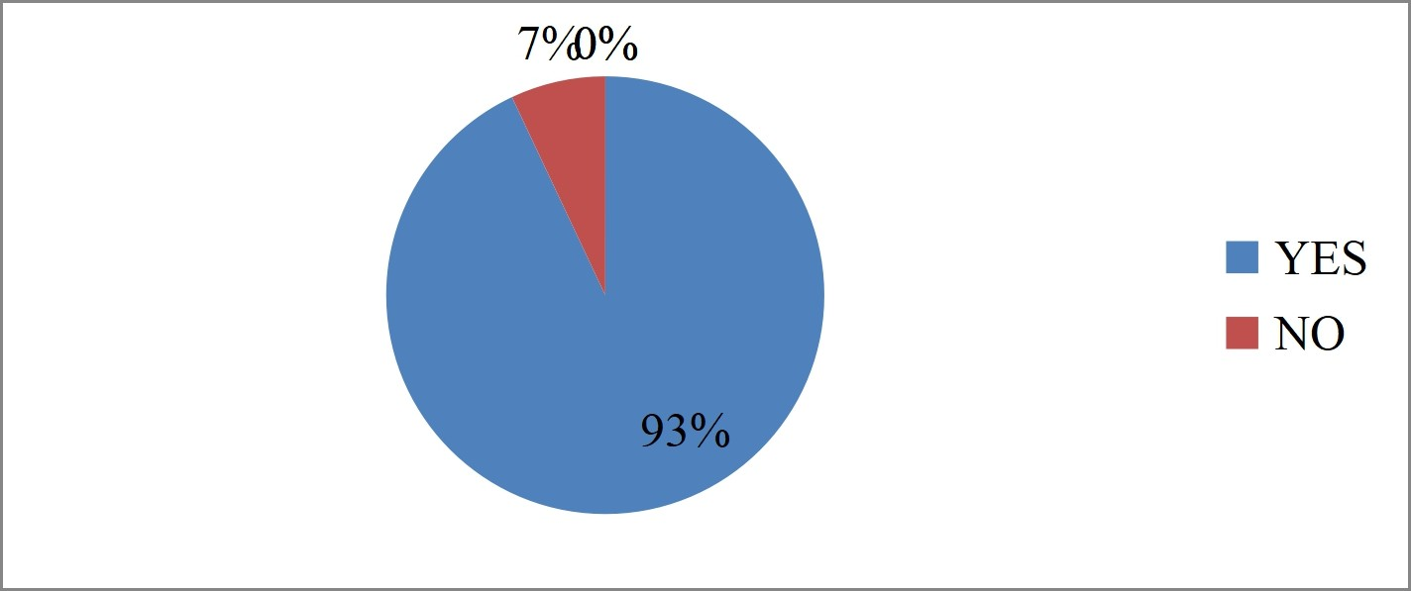
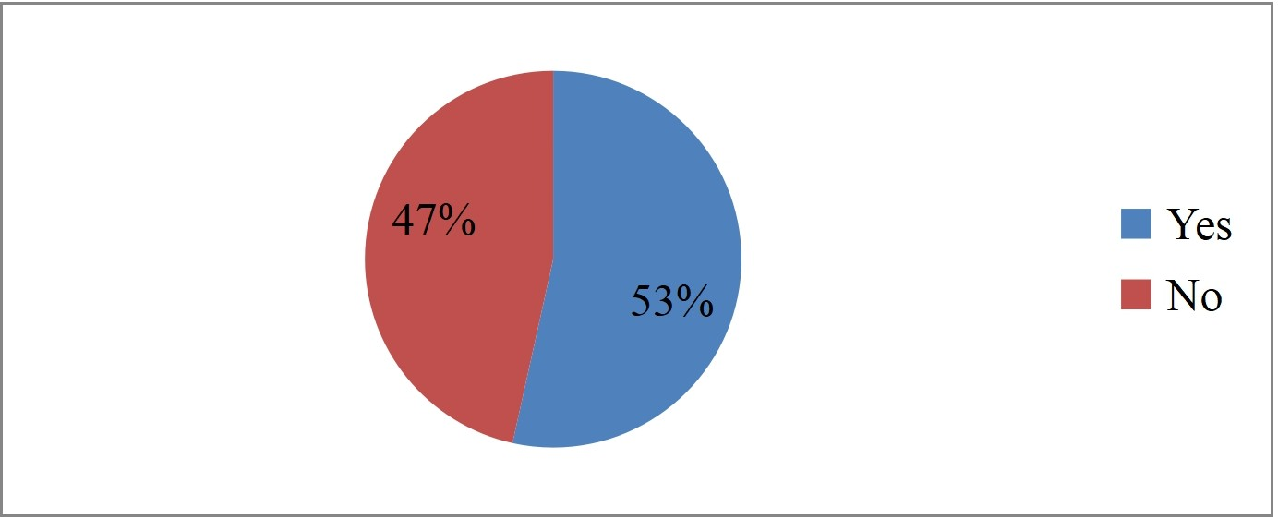
People who said they purchase products from online they purchase electronic products, followed by fashion and travel accessories through online.
5. Do you watch television?
Responses | Response for 'Yes' | Response for 'No'
50 | 46 | 4
Question asked to various age people and most of them said yes about 93% people said they watch television only 7% said NO to television.
6. Do you watch television programs through online?
Responses | Response for 'Yes' | Response for 'No'
50 | 27 | 23
Survey results showing that almost equal percentage of results.53% people watch TV programs through online.

Slide 17
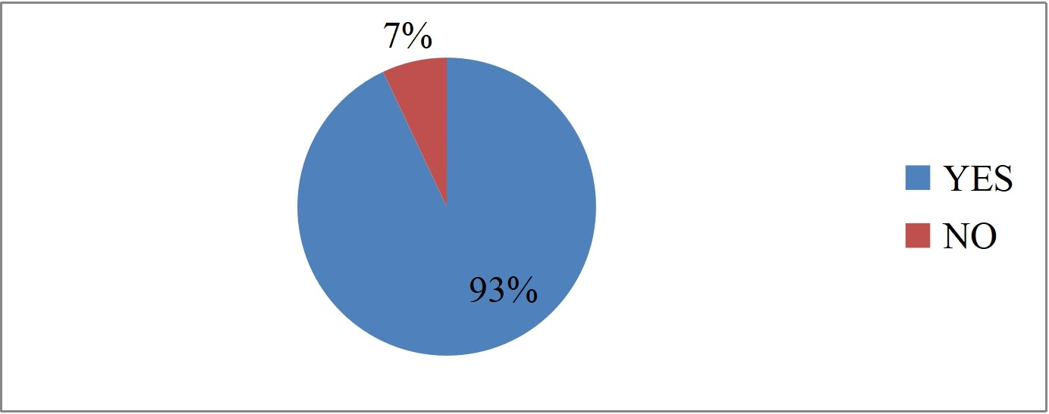
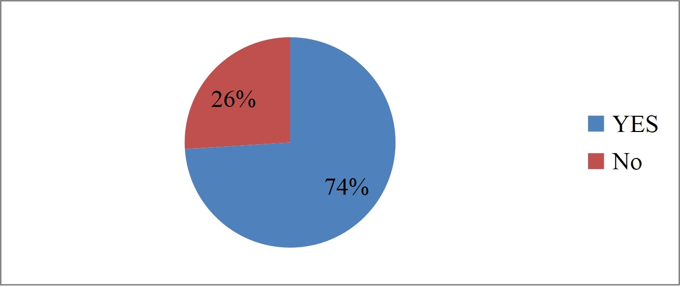
7. Do you read Newspapers?
Responses | Response for 'Yes' | Response for 'No'
50 | 47 | 3
Question asked to various age people 93% people said they read newspaper only few people said no to reading newspaper
8. Do you read the News through online?
Responses | Response for 'Yes' | Response for 'No'
50 | 37 | 13
93% people said YES to reading newspapers, 74% are reading newspapers through online portals and only 26% people said NO to read newspaper through online.

Slide 18
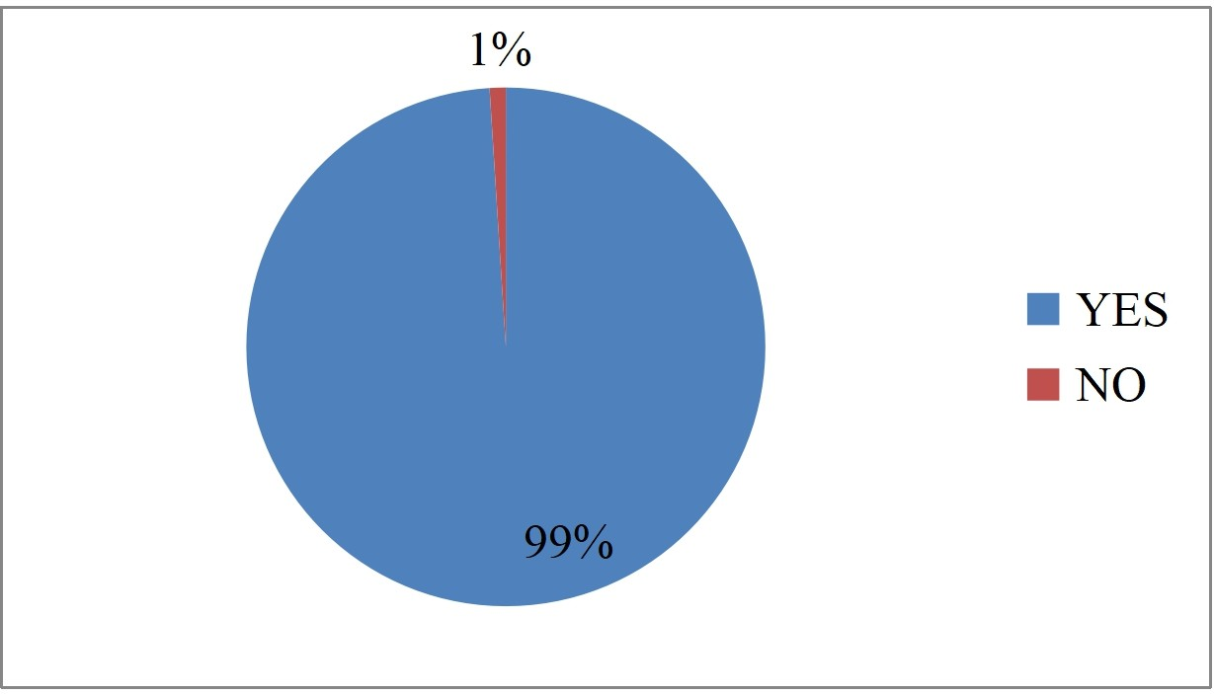
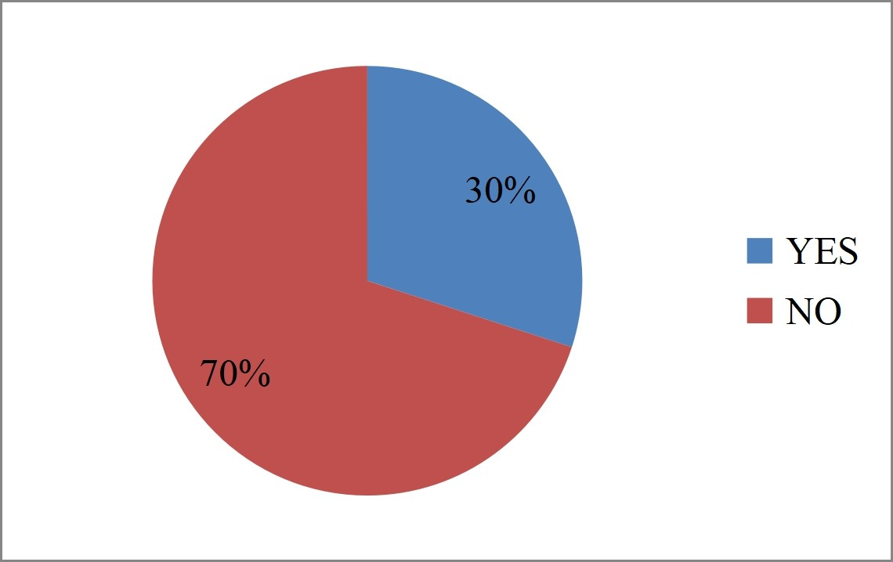
9. Do you have mobile phone?
Responses | Response for 'Yes' | Response for 'No'
50 | 49 | 1
Question asked to various age people maximum number of people said yes that they have mobile phone 99% answered YES that they have mobile phone.
10. Do you have a tablet?
Responses | Response for 'Yes' | Response for 'No'
50 | 15 | 35
Question asked to same students and working professionals and collected results that 70% people have tablet only 30% people don’t have tablet.

Slide 19
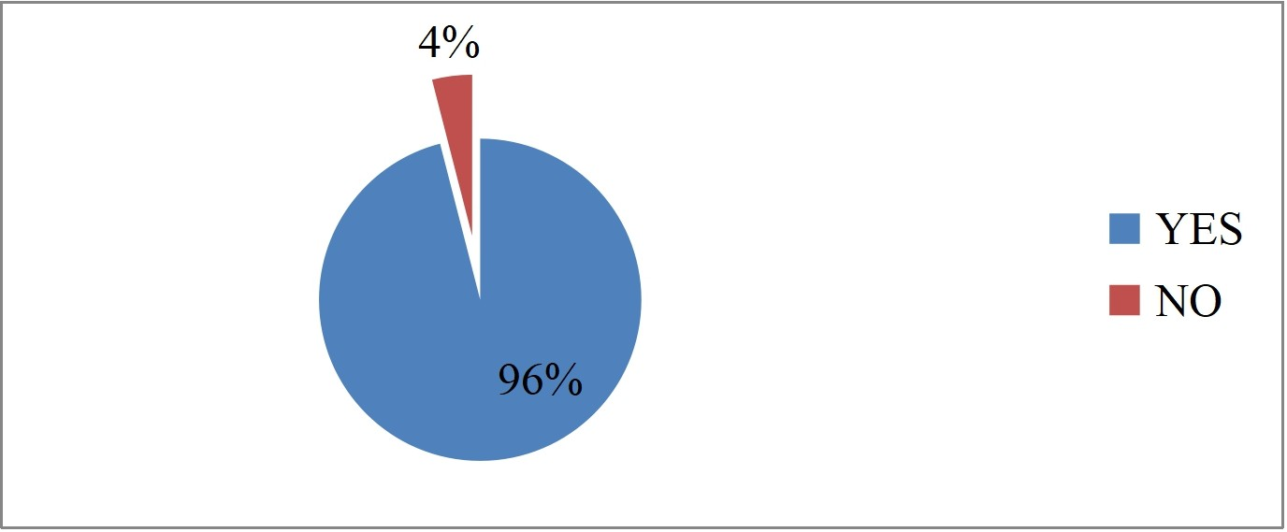
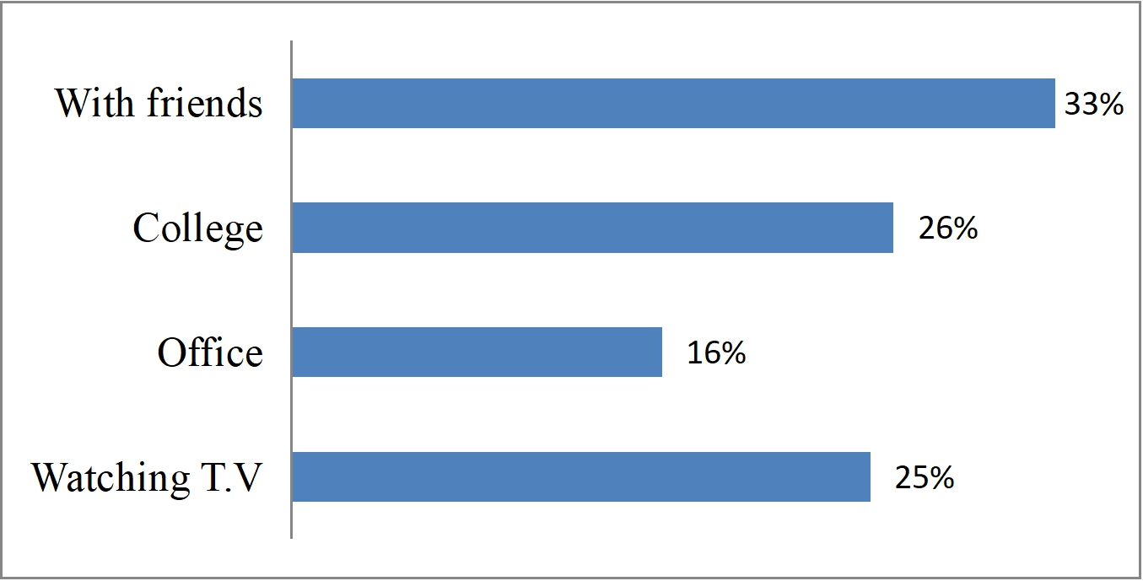
11. Do you have an internet connection in any of the above mentioned gadgets?
Responses | Response for 'Yes' | Response for 'No'
50 | 48 | 2
Question asked to people who said YES to above asked questions and 96% people have internet connection to any of those gadgets only 4% people using gadgets without internet connection.
12. When do you use these gadgets?
Responses | Response for 'With Friends' | Response for 'College' | Response for 'Office' | Response for 'Watching TV'
50 | 17 | 13 | 8 | 12
Survey results showing that 33% of people using gadgets when they are with friends and while watching TV.

Slide 20

5. COMPANY PROFILE
Branex, a digital marketing firm with a performance-based pricing strategy, is Gearing up to serve clients in over 150 cities in USA, in addition to setting up shop in Singapore and the Middle East by the end of next fiscal.
MISSION:
Customer Satisfaction is our primary objective and we strive for Excellence in it. End user Contact and Immediate Problem Resolution is our Strength.
VISION
Our vision is to set the high standards for Digital marketing & Technology around the world, across all industries through hard work, innovation and creativity until the preferred outcome is achieved.
WHAT THEY DO
Branex’s services entail Facebook brand building suite, Twitter strategyplanning and implementation, social media platform connects, strategy on social media applications and SEO and Google AdWords PPC. Its clientele spans across sectors and includes companies such as Myntra, Infibeam, Indus League, HI design, MakeMyTrip and Toyota, to name a few. While 75 per cent of its clients are acquired through referrals and online marketing.
Digital Marketing and Customer Acquisition
From optimizing search campaigns to gain maximum leverage on media spends (SEM), to optimizing your internet property for gaining a better rank in organic search results (SEO), we ensure that you reach your objectives in the best possible way.

Slide 21


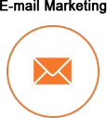

Plan companies social media campaigns to reach your exact target market with the right communication message.
Understanding brand message and creating interactive videos to showcase your brand presence is our speciality.
Creating custom mailer designs and execute them to drive your inbound marketing strategy.
Creating brand partnerships by leveraging an ecosystem with over 30,000 active partners.

Slide 22



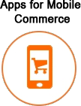
Omni Channel Strategy and Business Solutions:
Designing and developing, visually appealing and functional websites which are accessible to your audience across multiple platforms. We ensure that whatever we deliver has the highest quality of experience.
Creating integrated campaigns to create brand presence and recall in the mind of your audience.
We help understand the key pain areas of your CRM process and ensure the elimination of negative impression of your brand across the web.
Mobile App Development:

Slide 23
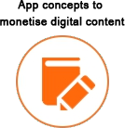

Specially designed enterprise and retail apps to ensure that your buyers can easily find and purchase products, leveraging technology in your favour to increase your revenues.
Our visualizers think out of the box every day, thus helping you to leverage on existing content through innovative concepts to gain revenue.
Apps specifically conceptualized and designed to meet your business objectives. Our team of highly skilled visualizers, designers and developers, ensure that your users will experience only the best.
Digital Media Distribution and Solutions:
Brand campaigns using a mix of media and marketing. We partner with some of the largest music labels globally.

Slide 24
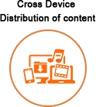

Distribution of music, videos & other digital content across devices. Our platform and analytics power some of the largest labels globally.
Want to launch a story telling campaign built around music/videos/films celebrities.

Slide 25
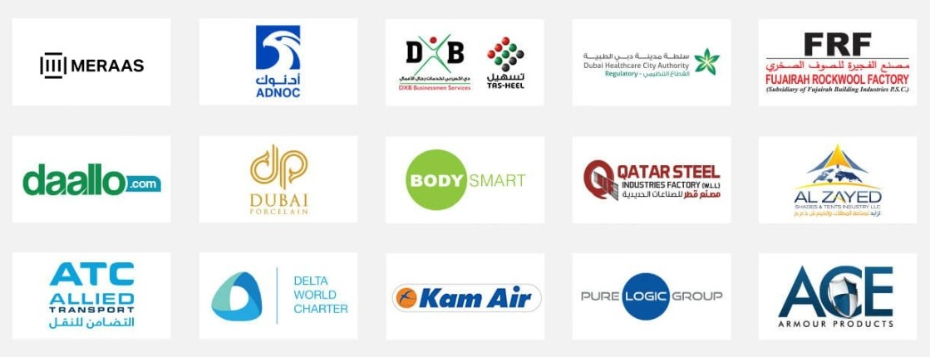
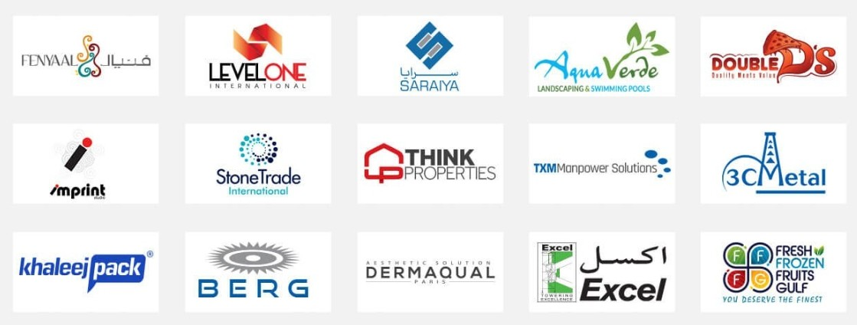
4.1 MAJOR CLIENTS OF THE COMPANY:

Slide 26
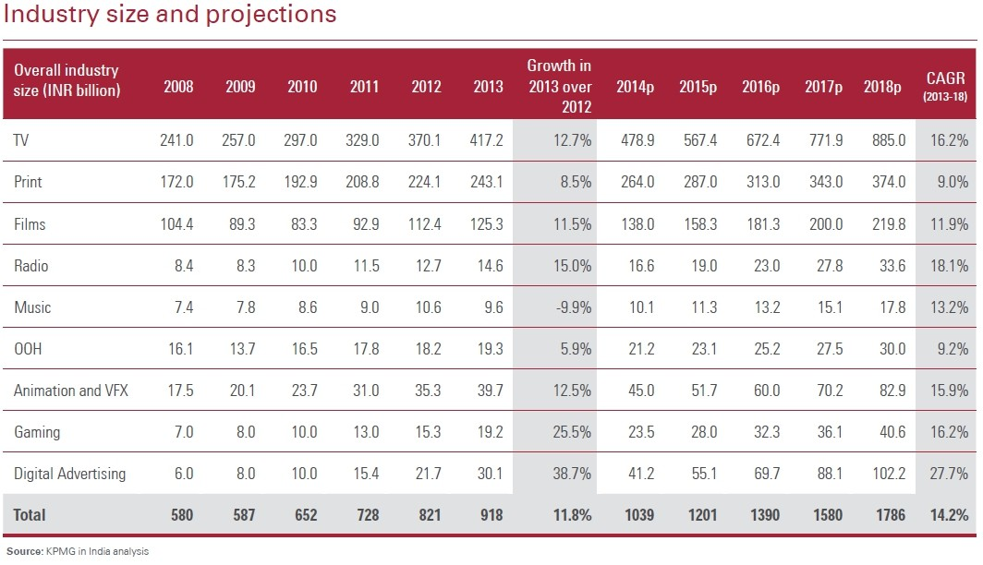
6. INDUSTRY ANALYSIS
The American Media and Entertainment (M&E) Industry, one of the most vibrant and exciting industries in the world, has had a tremendous impact on the lives and the American economy. As the M&E industry widens its reach, it plays a critical role in creating awareness on issues affecting, channelling the energy of and building aspirations among USA’s millions. As it entertains and informs the country, the M&E industry has been a catalyst for the growth of large parts of the American economy. M&E industry consist of TV, Print, Films, Radio, Music, OOH, Animation and VFX, Gaming and Digital Advertising.
The FICCI-KPMG 2014 Report 'The Stage Is Set' showing the American media and entertainment (M&E) industry has grown by 11.8 per cent in 2013 while comparing with 2012 and touched Rs 918 billion. It is expected to touch Rs 1785.8 billion by 2018, with a CAGR of 14.2 per cent.
By the end of 2014, the industry is expected to stand at Rs 1039 billion. Additionally, digital advertising has shown promising growth in 2013 while comparing with 2012, which is about 38.7 per cent, followed by gaming which grew by 25.5 per cent. As for the 2018 prediction: Digital advertising is expected to lead the CAGR with 27.7 per cent, followed by radio with 18.1 per cent. Gaming and television are expected to register a CAGR of 16.2 per cent each, followed by growth rates of animation and VFX (15.9 per cent), music (13.2 per cent), films (11.9 per cent) and OOH with 9.2 per cent expected CAGR.

Slide 27
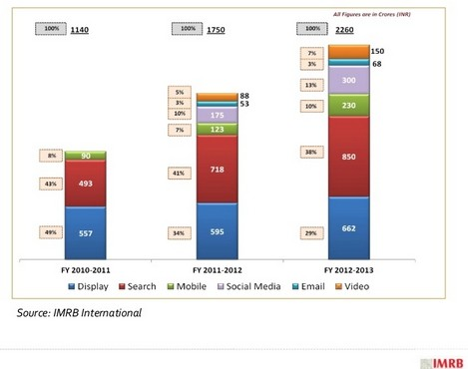
According to the annual advertising expenditure report from GroupM, The digital media advertising revenues for the year 2013 is estimated at Rs 2,520.1 crore (around $405 million) , up 30% from Rs 1,938.6 crore in 2012,. Digital contributed to 6.5% of the total media advertising expenditure in 2013, up from 5.5% share in 2012.
It is estimated that the total internet user base will reach 494 Million by the end of 2018 as against 938 million TV viewers in the same year. This means that the internet user population will be approximately 53 per cent of the total number of TV viewer in the country in 2018 compared to 27 per cent in 2013. This shift towards the digital media is important for digital media strategists to consider, in order balancing their marketing budgets between online media and traditional TV strategy.
IAMAI & IMRB report of March 2013 showing trends in breakup of Digital ad market among various ad types like search ads, display ads, mobile ads, social media ads, email ads and video ads. By seeing this breakup we can understand marketer are giving importance to all venues to place ads.
Some of the key players in the Digital advertising are Ogilvy & Mather, Web chutney, IBS, Isobar, Maxus, 22 Feet, Grey Digital, Mind Share, Interactive Avenues, Omnicom Media Group, Digital Law & Kenneth, Pinstrom.

Slide 28
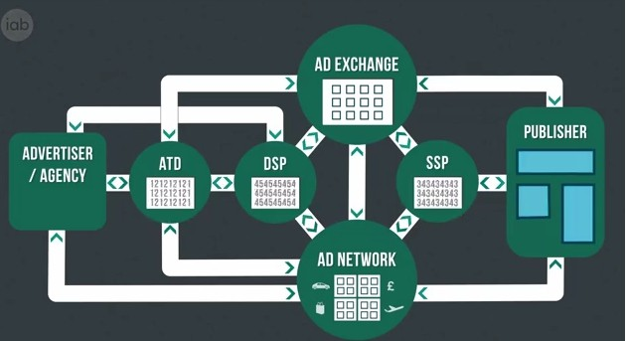
5.1 Business Model of Industry:
ATD- Agency Trading Desk
DSP- Demand Side Platform
SSP- Selling Side Platform
5.1.1 About Process
Clients would give authority to agencies, to wear the shoes of clients. Agency will create ads, which may be banner ads or videos. After the creation and getting approval from clients, agency while find out the portals or websites where the T.G is present. Later give the order to DSP or ATD, this order contains details regarding where to place ads or which portal is requiring to placing the ad. This DSP/ ATD will bid in ad exchange for that portal. Otherwise agency can directly approach to ad networks and give orders. These ad networks buy the inventories from publisher and give to agency. From publisher view he can sell inventories through Ad networks or through SSP. If publisher give to SSP, they will place those space in ad exchange for bidding. Through ad exchange DSP/ATD will buy those inventories. Bidding will not only for space but also for T.G which required for clients.
Ad exchanges are technology platforms that facilitate the bids for buying and selling of online media advertising inventory from multiple ad networks. The approach is technology-driven as opposed to the historical approach of negotiating price on media inventory.
A demand-side platform (DSP) is a system that allows buyers of digital advertising inventory to manage multiple ad exchange and data exchange accounts through one interface. Real-time bidding for displaying online ads takes place within the ad exchanges, and by utilizing a DSP, marketers can manage their bidsfor

Slide 29
The banners and the pricing for the data that they are layering on to target their audiences. A supply-side platform or sell-side platform (SSP) is a technology platform, web publishers of the world use a supply- side platform to automate and optimize the selling of their online media space.
Porter’s Five Model Analysis of Digital Advertising Industry:
Porter’s model will help analysis the industry and understand where the power lies in the business. Here I am using porter’s model to understand digital advertising industry in USA. Generally, in the American advertising industry, contracts are long termed, and customers are likely to keep going back to the same advertiser so long as results were obtained the first time.
Threats of New Entry
Full service agencies have high demand in Market.
Lack of getting efficient work force is a threat in digital advertising.
Cost of setting up a digital agency is low. But agencies need to invest a huge amount in backend function like technology.
Getting clients in the initial stage is a bit difficult, because clients will usually look the past
experience of agency.
Government regulations in the digital advertising are low. While comparing with M&E industry.
Bargaining power of suppliers
Lot of suppliers are there, but some suppliers who have high reach and affinity will charge high price for placing ads in their portals.
Real time bidding will lead to increase the demand of some portals.
Bargaining power of suppliers, who provide data and information are very high.
Seasonal campaigns put pressure on supply side to charge high.
Employee or work force with proper knowledge is limited.
Bargaining power of buyers
Buyer are the clients of agencies, basically buyers are high idea seekers.
Clients will choose agencies which have good experience in industry.
Clients like long term relationships with agencies, so they also try to adjust with agencies.
Clients can ask agencies to change pattern of campaigns at any time.
Clients like MNC’s have high power over agencies, but SME’s will satisfy with performance of agencies.
Backward integration by buyers is not possible.
Threats of substitutes
No. of substitutes is high, substitutes include Print media, TV, OOH and Radio.
Substitutes are too popular among buyers. They had high demand in past years.

Slide 30
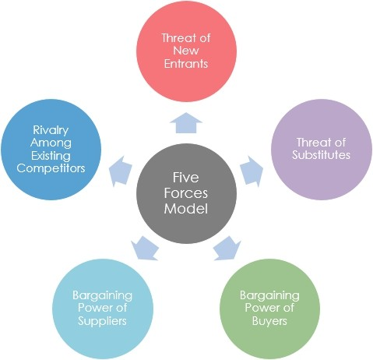
Main competitor for Digital advertising is TVC, but trends are now changing FICCI-KPMG report of 2014 showing growth of digital is very high while comparing with others media.
But media consumption through radio is increasing now.
Rivalry by existing competitors
At present competitors are low, but it can be increase in future. Because lot new players are coming to the industry.
Existing competitors have high profile clients and clients loyal toward them.
Most of the traditional agencies are now concentrating in digital also.
Existing firms in the Industry are creating variety and unique campaign for clients.
Most of the firms have efficient backend support in technology.
Existing firms have the expertise manpower and firms giving good remunerations to employees. So employees are loyal towards employers.
Some firms are popular due to execution of innovative campaigns.

Slide 31
Conclusion of Porter’s Five Force Analysis
Low threats for new entry.
High bargaining power of suppliers.
Bargaining power of buyer is medium, but in coming year there is chance for increase. Due to lot of players are coming to industry.
Threats of the substitutes are high, but it will change in coming years.
Rivalry by existing competitors is high, but possible to break it by doing some unique campaign for client.
American market is a potential market for digital advertising due to high internet and mobile penetration.

Slide 32
7. LITERATURE REVIEW
1. Neelika Arora 32has published research article entitled “Trends in Online Advertising” in advertising Express, Dec2013.
The global online advertising revenues are expected to touch US $10bn by 2015. In USA, the revenues at
present are estimated to be Rs.80 cr. and are expected to increase six times more within the next five years. In USA, Internet as a medium is accepted by a wider industrial segment that includes automobiles, telecom, education, banking, insurance, credit cards, FMCG (Fast Moving Consumer Goods), apparel/clothing, durables, media, business services and tourism. Out of these, it is estimated that the banking, FMCG and insurance sectors together account for 45% of the total advertising spend. In comparison to this, automotive, travel and retail spend 37% of the total advertising revenue and financial service companies spend 12% only. Some of the top spenders in USA are automobiles, followed by brands like Pepsodent, Kelloggs, Cadbury,
HDFC (Housing Development Finance Corporation Ltd.) loans and Sunsilk. In addition to these the early adopters in the field of finance and IT are also increasing their spending. Globally, the trend is that almost 60% of the revenue goes to five firms- Goggle, Yahoo, Microsoft, AOL(America Online Launchers), and Overture. Approximately, 90% of the Goggle revenues come from advertising. In USA, portals like USAtimes.com, exchange4media.com, rediffmail.com, agencyfaqs.com etc are attracting major online spender.
This article explains demographic profile of American users. It also gives the comparison between global trend and American trend, which is useful for my research work.
Sumanjeet37 has published article on “On Line Banner Advertising” in American Journal of Marketing.
Online banner advertising has great potential as an advertising medium. It is easy to create, place and use. It offers companies targeting well educated, innovative, affluent males/females or students with great potential for success as their segments are highly represented.
Jaffrey Graham45 has published his article entitled “Web advertising’s future e-Marketing strategy” Morgan Stanley Dean Witter published an equity research report analysing the Internet marketing and advertising industry. The report studies research from dozens of companies and calculates the cost and effectiveness of advertising across various media. Branding on the Internet works. For existing brands, the Internet is more effective in driving recall than television, magazines, and newspapers and at least as good in generating product interest.

Slide 33
Advertising in social media: How consumers act after seeing social ads. Adapted from Nielsen (2012: 10). Social media has not only changed how people communicate online, but it has also changed the consumption of other media too. Online social connections are used to filter, discuss, disseminate, and validate news,
entertainment, and products for consumption. (Ryan 2011: 15) The next chapters will explain more about each of the world‘s current most widely used social medias. There are, of course, many other social networks and applications (apps) available but considering the study, the focus is on the main Medias.
Vikas Bondar has published his article on “sales and marketing strategies” Internet is a really good thing. The Internet gives people a gre ater amount of information as we need. It is the best way to get a comparison of the products that we need. If we are interested in buying, it is best for us to check the Web sites. Also if we would like to make our own Web page we can do this, without paying a lot of money. From where do we set all this information? The answer is from advertising, which we see, everywhere: on TV, on the Internet, in the newspapers and more. Year after year we get more and more new, interesting information and in the future the Internet use will increase more than now. This article explains how internet is useful tool for advertisement.
According to Garder‘s survey (2013), the top priority in digital marketing investment will be to improve commerce experiences through social marketing, content creation and management and mobile marketing. Key findings also revealed that a company’s marketing success relies mostly on their website, social marketing, and digital advertising, which are all parts of digital marketing. In addition, savings made by using digital marketing can be reinvested elsewhere. Normally, companies spend 10 percent of their revenue on marketing and 2.4 percent on digital marketing, which will increase to 9 percent in the future.
J Suresh Reddy26 has published article in American Journal of Marketing. Title of article is “Impact of E- commerce on marketing”. Marketing is one of the business function most dramatically affected by emerging information technologies. Internet is providing companies new channels of communication and interaction. It can create closer yet more cost effective relationships with customers in sales, marketing and customer support. Companies can useweb to provide ongoing information, service and support. It also creates positive interaction with customers that can serve as the foundation for long term relationships and encourage repeat purchases.
Economic times published article on “American companies using digital marketing for competitive advantage” in Oct 2014.
According to this article a growing number of marketers in USA are leveraging digital marketing to increase their competitive advantage, a research by Adobe and CMO Council has revealed. According to the study, USA leads in the confidence in digital marketing as a driver of competitive advantage. Ninety-six per cent of the American marketers have high confidence in the ability of digital marketing to drive competitive

Slide 34
advantage. It is among the highest in Asia-Pacific APAC with only Australia leading with 97 per cent, the research said. However, while American marketers believe that the key driver to adopting digital is a growing internet population (70 per cent in USA against 59 per cent in APAC), their belief that customer preference and digital dependence drive the adoption of digital, and that digital can engage the audience, is lower than the APAC averages, it added.
The 2014 Adobe APAC Digital Marketing Performance Dashboard was compiled through quantitative surveys with over 800 marketers across the region.
Marketers from Australia, Korea, China, USA, Hong Kong, Singapore and other countries were covered. "However, while USA is an emerging leader in Digital Marketing, it has dipped in its own performance this year as compared to the previous year. It is important to note that USA scored much higher than the APAC average last year," it said.Adobe Managing Director South Asia Umang Bedi said that customer preference and digital dependence would increase along with the increase in penetration of internet in the American market. "Therefore, what would matter is how the American marketers are able to increase engagement and activate audience through digital marketing. This presents challenges in programme planning, execution and most importantly measurement," he added. The study also revealed that compared to their APAC counterparts, American marketers are receiving lesser support from channel and sales teams for increasing digital spends. However they are doing better as compared to last year suggesting that departments that have a customer interface are realising the importance of digital marketing in augmenting their effort.
9. Andy mallinson in digital marketing magazine on Jan 23 2015 published article titles how social media engagement will impact the retail space it says Retailers mustn’t underestimate the power of social engagement as a method of generating sales. This was proved by Wanted Shoes, who recently worked with us to design and integrate a ‘social catalogue’ onto their site. The social catalogue depicted real-life images of products that customers had recently purchased. When hovering over a post, users of the site were then directed to a link to buy the exact shoe displayed in the picture, or alternatively, were able to shop for other shoes from that designer.
Supporting the concept that that social media engagement can facilitate purchase orders, according to Nielsen, 77% of shoppers say ‘social exposure’ and validation to a product is the most persuasive source of information, and does indeed drive them to make more purchases. After all, we mustn’t forget how powerful the trust of our peers can be, and this has a direct impact of driving revenue.
As Wanted Shoes experienced, by showcasing its products in a customer driven catalogue, they were able to boost revenue and encourage more people to engage with their brand. Following this example as well as the other retail giants that have enjoyed impressive results through social channels, the retailer that ignores the power of social engagement in 2015 could potentially miss out on a substantial revenue stream – one that could decide the difference between success and failure in an increasingly competitive retail landscape.

Slide 35
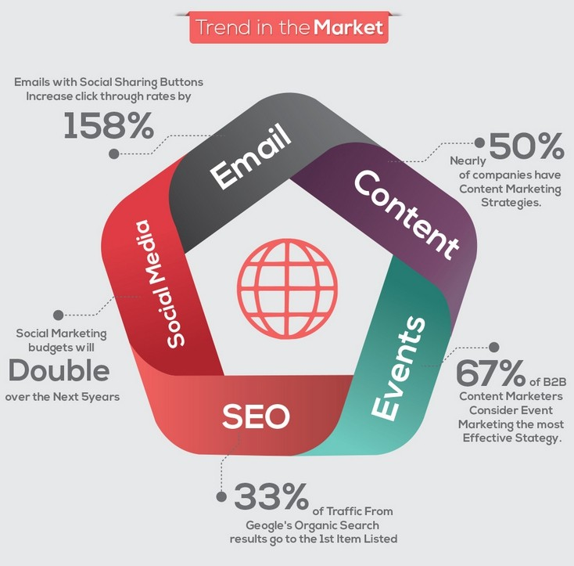
8. DIGITAL MARKETING
Meaning:
Digital Marketing (also Online Marketing, Internet Marketing or Web Marketing) is a collective name for marketing activity carried out online, as opposed to traditional marketing through print media, live promotions, tv and radio advertisement.
The rapid growth of Digital Marketing Industry is a direct consequence of the global phenomenon that is the Internet, and effectiveness of Digital Marketing channels in generating revenue and awareness. Compared to traditional methods of advertising, Digital Marketing offers rather realistic costs (particularly important for small- and medium-size businesses and start-ups), accurate targeting and excellent reporting.
7.1 Types of Digital Marketing
In normal outbound marketing, we will use pull and push marketing strategy. Like that in digital marketing also pull and push are types.

Slide 36
In push digital marketing the marketer sends a message without the recipient actively seeking the content, such as display advertising on websites and news blogs. Email, text messaging and web feeds with customized
Contents can also be classed as push digital marketing when the recipient has not actively sought the marketing message. Push marketing allows you to target your demographics and use your marketing dollars to promote your product to the people you know are interested in what you have to sell. A push marketing campaign can be more expensive when it comes to upfront costs, so you really need to be sure that your marketing is going to reach the right people at the right time. Behaviour targeting is good example for push digital marketing.
In Pull digital marketing includes blogging, email marketing, social media, info graphics and other forms of visual messaging and search engine optimization (SEO). A pull marketing campaign also includes public relations or other ways of reaching out to potential or already realized customers who you want to keep engaged.
While a pull marketing campaign can be less expensive to get started, you will incur costs in other ways. For example, if you are running a social media campaign, you will need to hire someone to manage your social media and respond to people who leave comments or ask questions. Social media gets people talking and that has a major impact on sales.
Pull marketing also requires a greater investment in time, but it gives you more ability to entertain your customers and educate them about your company. But don't get confused by seeing Email in push and pull, there is a difference. If marketer is sending emails with customized content or banners to specific group of customers is push digital marketing. If marketer is sending emails with the same content or banner to all customers is pull digital marketing.

Slide 37
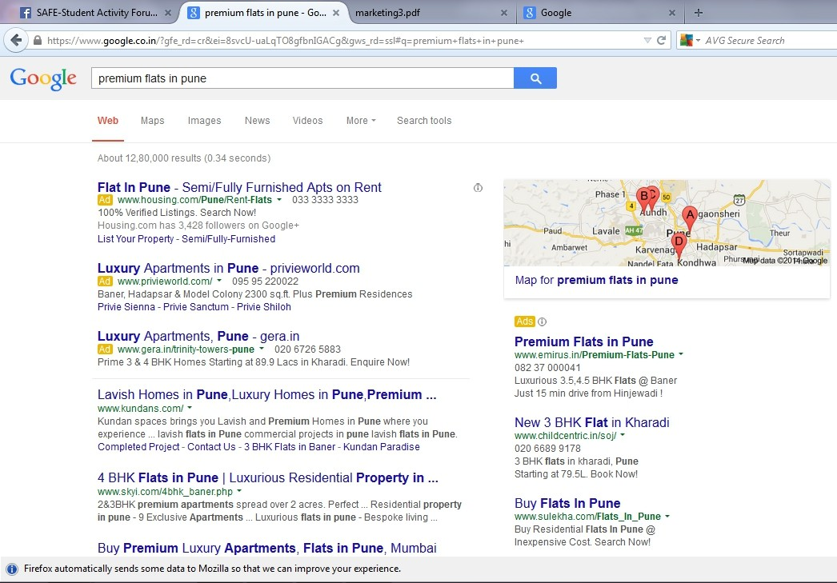
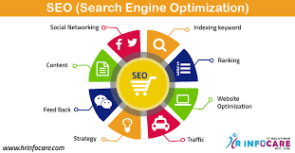
9. DIGITAL MARKETING CHANNELS:
8.1 SEO (Search Engine Optimization):
Search engine optimization (SEO) is the process of affecting the visibility of a website or a web page in a search engine's "natural" or un-paid ("organic") search results. SEO may target different kinds of search, including image search, local search, video search, academic search, news search and industry-specific vertical search engines.
As an Internet marketing strategy, SEO considers how search engines work, what people search for, the actual search terms or keywords typed into search engines and which search engines are preferred by their targeted audience. Optimizing a website may involve editing its content, HTML and associated coding to both increase its relevance to specific keywords and to remove barriers to the indexing activities of search engines. Promoting a site to increase the number of back links, or inbound links, social book marking, directory submission is the SEO tactic.
SEO OR ORGANIC
8.1.1 Directory submission
It is a part of SEO (Search Engine Optimization) off page work. Directory Submissions is a process of
submitting your Website URL to theme related Directory like if your site is Health Related you should
Submit your site URL to Health related directories sites for getting Back link from them.

Slide 38
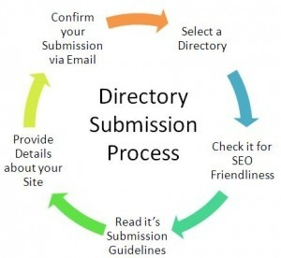
Types of Directories: –There are basically three types of Directories Submissions
Paid or Featured Web Listing: – In this type of Directories Submission the owner of Directories Site Will Charge for Submission and your link will approved hand to hand or within 24 hours you will get fast back links from this type of submission. Some sites offer this package for yearly or lifetime.
Free or Regular Web Listing: – It is free for Directory Submission no one charge for free or regular submission but there is no guarantee for getting approved your link by Administrator and it will take lots of time.
Reciprocal Regular Web Listing: – In this a reciprocal link must be submit to your site when you activate Directory Link then Directory administrator will approve your link.
Types of Directory Submission Ways
Automated Directory Submission: – In this way of submission many software and tools are used to submit directories it will save time and with the help of automated huge amount of submission done in short time.
Manually Directory Submission: – It is done by manually and it will take lots of time to do directory submissions.
Process of Directories Submissions
Open a Directory Site
Click on Submit Link
Choose your link type like Reciprocal Link Free, Regular Link Free and Featured Lifetime Link.
Fill your Site Title
Fill your Website URL
Fill Owner Name
Fill Owner E-mail id
Fill if you Choose Reciprocal Link
Fill Website Description
Choose Category related to your Site
Then Click on Submit Link
Then Confirmation Message will Display for your Submission and you will received a confirmation mail you must confirm it by clicking that link some sties send confirmation mail some doesn’t send it.

Slide 39
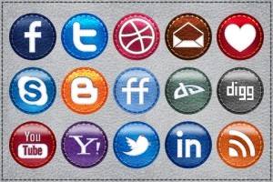
8.1.2 Social bookmarking:
Essentially, a social bookmark is a link that people post to social websites for others to see because they find it interesting, valuable or cool. In a way, social bookmarks are just like the bookmarks you already have on your private computer. The difference between the two is that social bookmarks are saved to the web where they can be easily shared while private bookmarks are saved to your own browser. The idea behind social bookmarking is simple: post links on popular social bookmarking websites to increase your own traffic and gain an ongoing stream of new readers and customers. Content that are openly shared with other Internet users literally have unlimited growth potential. For example, one link can quickly multiply and reach thoAmericands of desktops across the world if one user passes it on to others, and those users in turn do the same, and so on. Online marketing has gravitated away from true-and-tried ad and affiliate marketing toward the rapidly growing world of global social networking. Social bookmarking is a great traffic-boosting search engine optimization (SEO) strategy because it’s easy, effective and trendy.

Slide 40
8.2 SEM (Search Engine Marketing):
Search engine marketing (SEM) is a form of Internet marketing that involves the promotion of websites by increasing their visibility in search engine results pages (SERPs) through optimization and advertising.] SEM may use search engine optimization (SEO), which adjusts or rewrites website content to achieve a higher ranking in search engine results pages, or use pay per click listings.
SEM/PAID ADS
SEM/PAID ADS
There are four categories of methods and metrics used to optimize websites through search engine marketing.
Keyword research and analysis involves three steps ensuring the site can be indexed in the search engines, finding the most relevant and popular keywords for the site and its products, and using those keywords on the site in a way that will generate and convert traffic. A follow-on effect of keyword analysis and research is the search perception impact. Search perception impact describes the identified impact of a brand's search results on consumer perception, including title and Meta tags, site indexing, and keyword focus. As online searching is often the first step for potential consumers/customers, the search perception impact shapes the brand impression for each individual.
Website saturation and popularity, or how much presence a website has on search engines, can be analyzed through the number of pages of the site that are indexed on search engines (saturation) and how many backlinks the site has (popularity). It requires pages to contain keywords people are looking for and ensure that they rank high enough in searchengine rankings. Most search engines include some formof link
Popularity in their ranking algorithms. The following are major tools measuring various aspects of saturation and link popularity: Link Popularity, Top 10 Google Analysis, and Market leap’s Link Popularity and Search Engine Saturation.
8.2.1 Pay per click (ppc):
Pay per click (PPC), also called cost per click, isan internet advertising model used to direct traffic to websites, in which advertisers pay the publisher (typically a website owner) when the ad is clicked. It is defined simply as “the amount spent to get an advertisement clicked.”
With search engines, advertisers typically bid on keyword phrases relevant to their target market. Content sites commonly charge a fixed price per click rather than use a bidding system. PPC "display" advertisements, also known as "banner" ads, are shown on web sites or search engine results with related content that have agreed to show ads.

Slide 41
In contrast to the generalized portal, which seeks to drive a high volume of traffic to one site, PPC implements the so-called affiliate model, which provides purchase opportunities wherever people may be surfing. It does this by offering financial incentives (in the form of a percentage of revenue) to affiliated partner sites. The affiliates provide purchase-point click-through to the merchant. It is a pay-for-performance model: If an affiliate does not generate sales, it represents no cost to the merchant. Variations include banner exchange, pay-per-click, and revenue sharing programs.
Pay-per-click = Advertising cost ÷ Ads clicked
There are two primary models for determining pay-per-click: flat-rate and bid-based. In both cases, the advertiser must consider the potential value of a click from a given source. This value is based on the type of individual the advertiser is expecting to receive as a visitor to his or her website, and what the advertiser can gain from that visit, usually revenue, both in the short term as well as in the long term. As with other forms of advertising targeting is key, and factors that often play into PPC campaigns include the target's interest (often defined by a search term they have entered into a search engine, or the content of a page that they are browsing), intent (e.g., to purchase or not), location (for geo targeting), and the day and time that they are browsing.
Flat-rate PPC
In the flat-rate model, the advertiser and publisher agree upon a fixed amount that will be paid for each click. In many cases the publisher has a rate card that lists the pay-per-click (PPC) within different areas of their website or network. These various amounts are often related to the content on pages, with content that generally attracts more valuable visitors having a higher PPC than content that attracts less valuable visitors. However, in many cases advertisers can negotiate lower rates, especially when committing to a long-term or high-value contract. The flat-rate model is particularly common to comparison shopping engines, which typically publish rate cards.However, these rates are sometimes minimal, and advertisers can pay more for greater visibility. These sites are usually neatly compartmentalized into product or service categories, allowing a high degree of targeting by advertisers. In many cases, the entire core content of these sites is paid ads.
Bid-Based PPC:
With the bid-based PPC model, the advertiser is allowed to bid, to compete against similar advertisers in a private auction. Each of the bidding advertisers lets the publisher know the maximum amount they are willing to pay for a given ad spot or keyword. The winning advertisers then pay for each click on their advertisement, based on the amount they bid. The common practice amongst bid-based PPC websites such as Google Ad Words, is to charge a small amount more than the next highest bidder. As you can see, Payper Click can be a massively effective means of directing targeted traffic to your website, and is relatively inexpensive. While there is the risk of click fraud, most of the major Pay Per Click providers such as Google or Yahoo, have employed several automated systems to prevent abusive clicks by corrupt web developers or competitors out to cost you additional money. If used properly, you can find new customers with ease using Pay per Click. It might also be beneficial to find a reputable pay per click company to assist you with your campaigns.

Slide 42
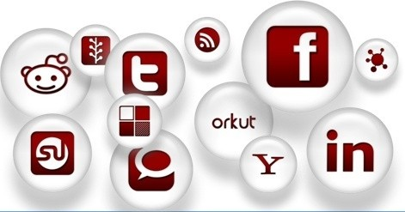
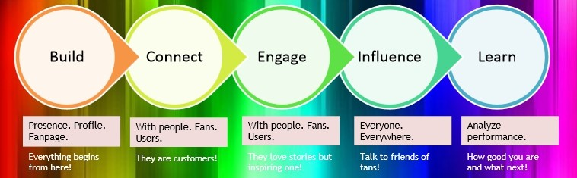
8.3. SMM (Social Media Marketing):
Social media marketing is the process of gaining website traffic or attention through social media sites. Social media marketing programs usually center on efforts to create content that attracts attention and encourages readers to share it across their social networks. The resulting electronic word of mouth (eWoM) refers to any statement consumers share via the Internet (e.g., web sites, social networks, instant messages, news feeds) about an event, product, service, brand or company. When the underlying message spreads from user to user and presumably resonates because it appears to come from a trusted, third-party source, as opposed to the brand or company itself, this form of marketing results in earned media rather than paid media.
Engagement
In the context of the social web, engagement means that customers and stakeholders are participants rather than viewers. Social media in business allows anyone and everyone to express and share an opinion or an idea somewhere along the business’s path to market. Each participating customer becomes part of the marketing department, as other customers read their comments or reviews. The engagement process is then fundamental to successful social media marketing.
Facebook Marketing
Facebook is the world's mostpopular social network for both businesses and individuals. With over one billion users, your friends and fans are likely already using the platform and you should be too. In fact, people are 51% more likely to make a purchase after "liking" a brand on Facebook. Face book marketing requires a good intellects and unique thinking to make the campaign effective.

Slide 43
In face book marketing in fact in visual /web marketing your content speaks a loud that is why make sure your content should be relevant to your audience and business.
Facebook is a low-cost marketing strategy
Marketing activities that would cost the Americands of dollars through other channels can be used on Face book for a fraction of the cost. This makes it ideal for small to medium businesses with a limited marketing budget. Larger businesses can also trial marketing concepts and themes through Facebook before committing to bigger campaigns.
Share basic information about your business
Your Facebook page is a place where you can publicise your business name, address and contact details, and briefly describe your products and services. You can also talk about your staff, history, or any other aspect of your business that is likely to attract other Face book users and create interest in what you do.
Share pictures and videos from your business
As well as allowing you to post text, Face book lets you upload pictures and videos from your business. This can be a powerful way to communicate with customers and potential customers, allowing them to see your product or service without having to visit your premises.
Facebook also allows users to 'tag' photos to indicate if a Face book friend appears in them. This function can be used to promote your business. For example, a tour operator could post a photo on their page of a group going white-water rafting, then invite each participant to tag their image in the photo. Each tagged image will show up as an update on the participant's Facebook account, where their friends will see it too. This increases the level of interest in the picture, and your business.
If you do decide to use tagging, be careful. It can be a privacy issue, and some Facebook users are sensitive about being tagged in photographs. For this reason, it is better to ask participants to do the tagging, rather than doing it on their behalf. Talk to existing and potential customers.
You can use Facebook to 'talk' to existing and potential customers by posting and receiving messages. But don't use Facebook to aggressively promote your products or services. You'll have much greater success if you share information related to your business that is actually useful or interesting to other users. This increases your credibility and promotes your business by building long-term relationships with other users. For example, a veterinarian could post tips for looking after pets, timing them according to when particular health issues arise (e.g. ticks in summer).

Slide 44
You should also listen as much as you talk. Paying attention to what the market thinks about your business, your industry, a product or a marketing campaign can provide valuable insights.
Provide customer support
Customers can post after-sales questions on your Facebook wall, and your staff can answer them there. This is often more efficient than staff answering phone calls, and allows other customers to read common questions and answers without having to approach you individually.
Raise brand awareness and promote positive word-of-mouth
You can increase your business's profile on Facebook by encouraging existing and potential customers to click the 'Like' button on your Facebook page. Once they like your page, your customers will receive your updates on their wall, where their friends will also see them. This helps to build awareness of your business, and to associate your friends with your brand. Customers can also post positive messages about your products or services, shared on their walls for all their friends to see.
Facebook can steer traffic to your website
You can include a link to your website on your Facebook page. Indeed, many businesses report that the greatest benefit of Facebook is the extra traffic that it steers to their site. Visitors who come to the website can be exposed to stronger marketing messages and, often, the option of buying goods and services. Customers who come to your website from Facebook are likely to be more receptive than the average visitor, because they already know something about your business and were motivated to click the website link.
Targeted advertising
Facebook was designed as an interactive online forum that encourages members to share information via photos, video clips, links and written posts. While account owners ultimately have control of what remains on their public profile, there is little control over who posts information or what those posts contain. It is relatively easy for a competitor, angry customer or disgruntled employee to post accusatory comments that are inflammatory, derogatory or otherwise slanderous to your business on your Facebook wall. Even well- meaning posters may use language or photos that are not in line with the image you want to maintain for your business. Maintaining vigilant control over the content that appears on your Facebook page takes the time and effort of approved content monitors, which can be costly and time-consuming for small business owners.
Cost of Maintenance
Content pages must continually be updated with new information that readers will find useful, beneficial or interesting for Facebook marketing to be effective. This requires development of a detailed innovative social media marketing strategy a costly investment for small advertising budgets. Facebook marketing strategies include video product demonstrations, interactive forums and online contests, all of which must be created, uploaded, monitored and maintained by a business owner, staff member or social media advertising agency.
Competition
Marketing platforms executed via Facebook are open to easy duplication by competitors. Rival business owners can easily pose as “friends” or “fans” to gain access to your content. Photos, artwork and other images posted to your site are easily accessed and reused by visitors and can show up in other places you may not approve of.
Professionalism
Social media platforms like Facebook were created to facilitate the casual sharing of information that may not mesh with the professional reputation you want to establish for your business. For example, Facebook marketing of a nightclub needs to be vastly different from Facebook marketing of a doctor’s office or law practice. Care must be taken to develop and maintain a Facebook presence that reflects your corporate philosophy, or it could place your company at a disadvantage.
8.3.3 Twitter marketing (A game of 140 characters)
Twitter’s flexible, real-time platform allows you to get creative and drive results at the same time. Whether you’re looking to drive sales, increase brand awareness or launch a product. Twitter marketing is not much popular than face book but still it has an impact on audience

Slide 45
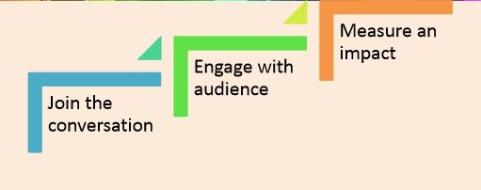
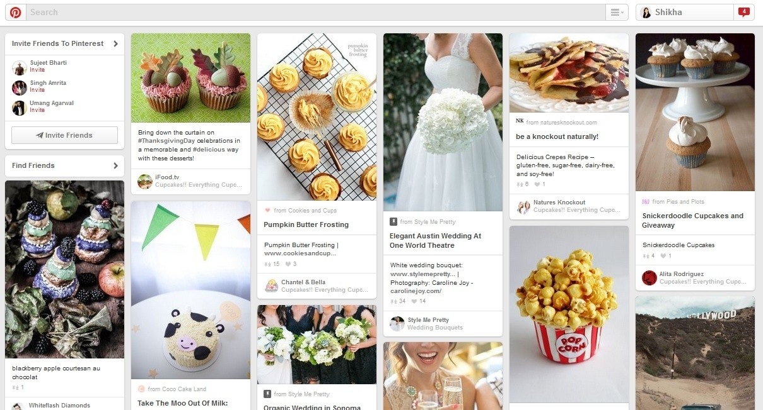
The very first thing in twitter marketing you need to understand and learn the twitter terminologies well.
.HASHTAG
A hashtag is any word beginning with the # sign. People use hashtags to organize conversations around a specific topic. Clicking on a hashtag takes you to search results for that term.
Pinterest:
It is a visual discovery social network. It is a way of sharing images of anything, from fashion to pets to pot plants. You can create your own online pinboards to suits any theme and share it with likeminded people.
Pinterest completely revolves around the premise of being creative and visual. 70% users are female and aged between 25 and 44. So if you are targeting women pinterest is the right platform. Pinterest is now one of the top 10 social networking sites tracked by Hit wise.
How brands can use pinterest
Pinterest does not encourage product pushing, this means brands must look at crating boards that are culture and lifestyle related. You can create boards on trends, behind the scenes, preliminary sketches for products.
8.3.6 Instagram:
Instagram, the new revolutionary photo-sharing program, making it easier than ever to share your best pictures with the world. The social media program allow you to upload, add digital filters, and then post your

Slide 46
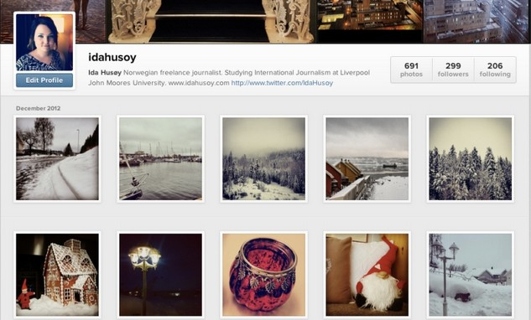
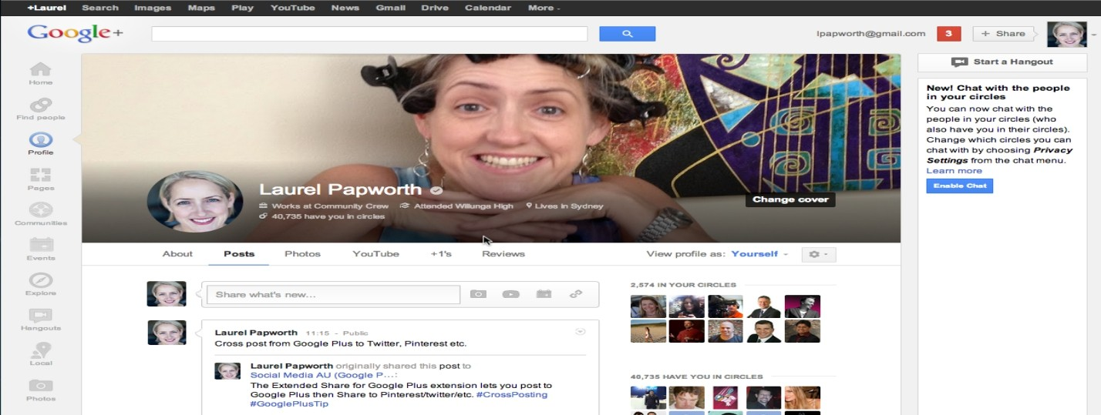
pictures on your Instagram-feed, as well as other social networking sites. You can connect your Instagram account with Facebook, Twitter, Tumblr, Flickr,Foursquare and your email account. This makes it easy to share your pictures on multiple platforms all at once.
When it comes to brands and businesses, Instagram goal is to help companies to reach their respective audiences through captivating imagery in a rich, visual environment. Moreover, Instagram provides a platform where user and company can communicate publicly and directly, making itself an ideal platform for companies to connect with their current and potential customers.
8.3.7 Google +:
Google has described Google+ as a "social layer" that enhances many of its online properties, and that it is not simply a social networking website, but also an authorship tool that associates web-content directly with its owner/author. It is the second-largest social networking site in the world after Facebook. 540 million monthly active users are part of the Identity service site, by interacting socially with Google+'s enhanced properties, like Gmail, +1 button, and YouTube comments.In October 2013, Google counted 540 million active users who used at least one Google+ service, of which 300 million users are active in "the stream".

Slide 47
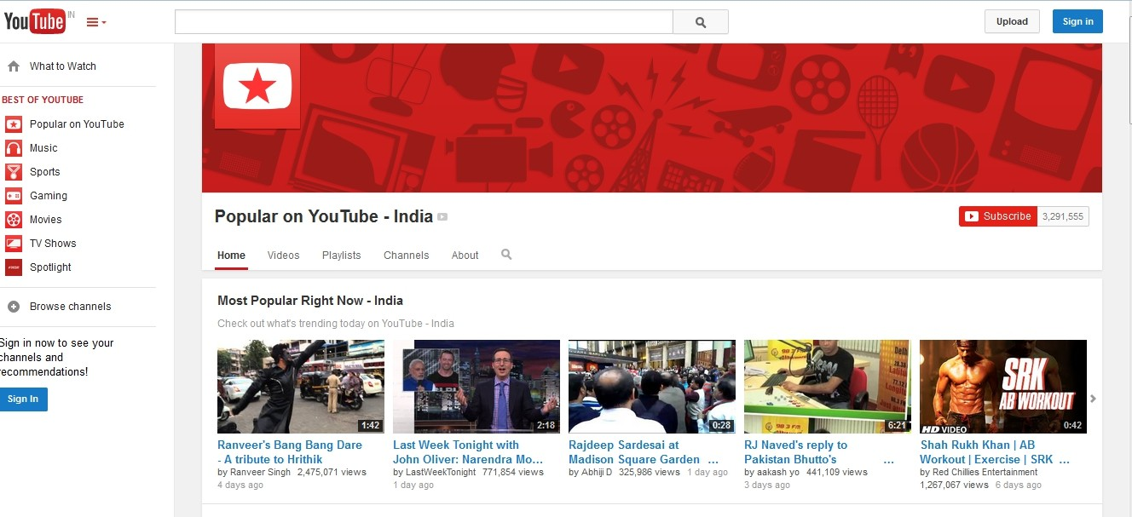
With most marketers comfortable with using Facebook for their primary social media marketing tactics they quite often don’t see the other opportunities. Here are some compelling reasons to register and start using a Google+ page to complement your Facebook page, your social media and digital marketing activities.
Google+ hangouts
Google+ hangouts have been an important part of the Google+ platform since day one. They allow you to create online meetings that are limited to 10 active users but it allows you to stream YouTube video to an unlimited number of viewers. Hangouts provide a way to engage with small groups of customers that you may want to share important information and/or educate.
No update filtering
Google doesn’t need to make money from Google+ as its major revenue (over $30 billion) is from its Google ad words and search advertising. It doesn’t need to force you to pay to be visible on Google+. Facebook has increasingly applied its Edge rank technology that filters the updates that are seen by people that have liked your brand’s “Facebook page”. Some research shows it at less than 15% and shrinking. This is so they can force you to spend to advertise on Facebook to get attention. It has become “pay to play” Google plus does not filter (censor) your updates to followers that are following your page.
No ads
Point two leads to another advantage. There are no annoying advertisements on Google plus. No distractions and no one wanting to sell you weight loss or dating services.
Social signals
Google wanted to enhance its search engine capabilities by having humans vote on what content they liked. (That is the Google+ button). This is now built into Google’s search algorithms to ensure that Google remains relevant on the web. This makes certain that your content is receiving votes (social signals) when you are participating on Google+.
8.3.8 You tube
YouTube is a video Social Networking site, and the 2nd most popular search site on the Internet after Google, who owns YouTube. YouTube video watching is a significant activity on the Internet, with over 1 billion visits to YouTube daily and over 100 million videos watched daily. And it's easy for anyone who sees your video to rate it and share it with his Social Network.

Slide 48
Pros:
Vast Audiences for your Video
The success of any business depend upon its visibility and youtube gives you that very much required exposure with little or no effort at all. It is just the matter of selection of uploading your video under right place, under right category. So it is very easy and more likely to reach masses when you use youtube for your videos, and hence chances of clever video to grab viewers’ attention and go viral, is quite high on youtube, when self-hosted videos(websites). Anybody can embed videos on their websites, blogs etc. and if good, your video will also be approachable from outside of youtube. In case you want your video to be viewed by selected number of people. You can do that by making it private.
Save Dollars with Free Video Hosting
If you are planning to host your videos on your own video hosting server or thinking about getting licence from a video platform then you have to take in account, this extra burden of dollars on your wallet. Though Google don’t promote commercial video sharing but has now made an amendment in the terms and conditions for sharing original contents of brands. It is one time investment and you would be happy to upload your content on YouTube as you are still saving the additional design and functional costs. Hence, if you compare the current cost for licences of video platform YouTube brand channel is a smart bet.
8.4 ODA (Online Display Ads):
Display advertising is a type of advertising that is located on websites. It can be seen in a wide range of
different formats and contains items such as texts, images, flash, video and audio. The main purpose is to
deliver general advertisements and brand messages to the plus 40 million people connected to the Internet each month.
It is important to choose the right format because it will help to make the most of the medium. It is also possible to add:
Video
Expendables: flash files that expand when the user interacts on mouse over
Overlays: ads that appear and that it is possible to remove clicking a close button;
Sponsorship: including a logo or adding a brand to the design of a web site.
To help to better selecting the right format for type of ad, Interactive Advertising Bureau has realized a Display Standard Ad Unit Portfolio that works as guideline that can be followed by the creative.
Standard size
IAB has also created a universal standard for display ad sizes Page text. There are four dimensions that have been decided as universal and are respectively:
Banner 728 x 90
Rectangle 336 x 280
Skyscraper 160 x 600
Square 250 x 250

Slide 49
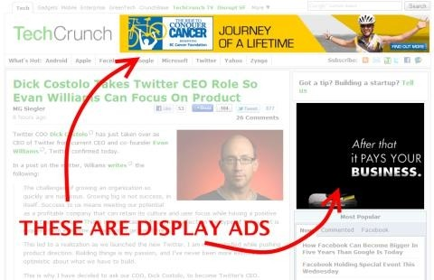
MMT (Mobile Marketing):
Mobile marketing is marketing on or with a mobile device, such as a Mobile marketing can plague customers with time and location sensitive, personalized information that promotes goods, services and ideas. In a more theoretical manner, academic Andreas Kaplan defines mobile marketing as "any marketing activity conducted through a ubiquitous network to which consumers are constantly connected using a personal mobile device".
Mobile marketing via SMS has expanded rapidly in Europe and Asia as a new channel to reach the consumer. SMS initially received negative media coverage in many parts of Europe for being a new form of spam as some advertisers purchased lists and sent unsolicited content to consumer's phones; however, as guidelines are put in place by the mobile operators, SMS has become the most popular branch of the Mobile Marketing industry with several 100 million advertising SMS sent out every month.
Ways of mobile marketing:
MMS
MMS mobile marketing can contain a timed slideshow of images, text, audio and video. This mobile content is delivered via MMS (Multimedia Message Service). Nearly all new phones produced with a color screen are capable of sending and receiving standard MMS message. Brands are able to both send (mobile terminated) and receive (mobile originated) rich content through MMS A2P (application-to-person) mobile networks to mobile subscribers. In some networks, brands are also able to sponsor messages that are sent P2P (person-to-person).
Good examples of mobile-originated MMS marketing campaigns are Motorola'songoing campaigns at House of Bluesvenues, where the brand allows the consumer to send their mobile photos to the LED board in real-time as well as blog their images online.
Mobile web marketing
Google and Yahoo! as on web pages specifically meant for access by mobile devices is also an option. The Mobile Marketing Associationprovides a set of guidelines and standards that give the recommended format of ads, presentation, and metrics used in reporting. Google, Yahoo, and other major mobile content providers have been selling advertising placement on their properties for years already as of the time of this writing. Advertising networks focused on mobile properties, SMS resellers and advertisers are also available. Additionally, web forms on web pages can be used to integrate with mobile texting sources for reminders about meetings, seminars and other important events that assume users are not always at their computers. In addition Mobile websites are another aspect of mobile web marketing and can be a tool than can used to help make purchasing goods and services easier as well as create better communication opportunities between trades.

Slide 50
QR codes
QR codes allow a customer to visit a web page address by scanning a 2D image with their phone's camera, instead of manually entering a URL. The resultant URLs typically include tracking features which would be unwieldy if typed by the customer. Originally approved as an ISS standard in 1997, Denso-Wave first
Developed the standard for tracking automobile parts in Japan.QR codes have been growing in popularity in Asia and Europe, but have been slow to be adopted in North America. Some high-profile QR campaigns in the United States have included billboards by Calvin Klein in Times Square, QR codes for every SKU in Home Depot and Best Buy stores, and a scavenger hunt promotingStarbucks and Lady Gaga.Apple pass bookImplemented as a native app for iOS6, has employed QR codes as one of the ways that the iPhone (or iPod Touch) users can take a real world action. I.e. scan the Barcode on their Passbook Pass. In addition to QR codes, the Passbook (application) also supports PDF417 and Aztec 2D Barcodes.
8.6 EMT (Email Marketing)
Email marketing is directly marketing a commercial message to a group of people using email. In its broadest sense, every email sent to a potential or current customer could be considered email marketing. It usually involves using email to send ads, request business, or solicit sales or donations, and is meant to build loyalty, trust, or brand awareness. Email marketing can be done to either sold lists or a current customer database. Broadly, the term is usually used to refer to sending email messages with the purpose of enhancing the relationship of a merchant with its current or previous customers, to encourage customer loyalty and repeat business, acquiring new customers or convincing current customers to purchase something immediately, and adding advertisements to email messages sent by other companies to their customers.
Types of email marketing
Email marketing can be carried out through different types of emails:
Transactional emails
Transactional emails are usually triggered based on a customer’s action with a company. To be qualified as transactional or relationship messages, these communications' primary purpose must be "to facilitate, complete, or confirm a commercial transactions that the recipient has previously agreed to enter into with the Sender", along with a few other narrow definitions of transactional messaging. Triggered transactional messages include dropped basket messages, password reset emails, purchase or order confirmation emails, order status emails, reorder emails and email receipts.
The primary purpose of a transactional email is to convey information regarding the action that triggered it. But, due to its high open rates (51.3% compared to 36.6% for email newsletters), transactional emails are an
opportunity to engage customers: to introduce or extend the email relationship with customers or subscribers,
to anticipate and answer questions or to cross-sell or up-sell products or services.
Many email newsletter software vendors offer transactional email support, which gives companies the ability to include promotional messages within the body of transactional emails. There are also software vendors that offer specialized transactional email marketing services, which include providing targeted and personalized transactional email messages and running specific marketing campaigns (such as customer referral programs).
Direct emails
Direct email or interruption based marketing involves sending an email solely to communicate a promotional message (for example, an announcement of a special offer or a catalog of products). Companies usually collect a list of customer or prospect email addresses to send direct promotional messages to, or they can also rent a list of email addresses from service companies, but safe mail marketing is also used.

Slide 51
10. AIDMA AS AISAS IN DIGITAL ERA
AIDMA widely accepted model describing the psychological process leading up to the consumer’s decision to purchase a product. This model is similar to AIDA model. The AIDMA Model was first advocated by Roland Hall, an American economist, around 1920.
According to this model, there are five key processes: Attention, in which the consumer first notices the product or advertisement, followed by Interest, Desire, Memory, and Action. This model has been used extensively in the advertising and marketing industries.
AISAS is a process model of consumers purchasing activities in the Internet age. AISAS is a consumption behaviour model that has been advocated by Dentsu since 2004. It was developed to observe behaviours based on the understanding that the Internet has become prevalent, and that consumers now have access to environments in which they can obtain and transmit information themselves.
In this model, the key processes are: Attention, in which the consumer first notices the product or advertisement, followed by Interest. After this, the consumer Searches for information, and then makes a purchase (Action), after which information is shared with others. In comparison to “AIDMA,” the psychological process has become more compact, and the Action process has expanded.
These changes are shown how presences in digital are important for brands. Brands can able to create awareness and internet without digital. But it will not lead to action in current scenario. Customers need more information in present era; they are information seeker and always search for best deal. Brands can’t sustain without digital media.
Advantages of Digital Marketing
Digital Advertising is increasingly an inherent budgetary component of many organizations today. Organizations of all sizes use the medium to promote their products and services. So well, why do so many organizations use the medium? Simply put, it is due to the numerous advantages that online advertising offers. These are discussed in the paragraphs ahead.
Reach
The ability of the online medium to target a certain demographic of users is one of the greatest advantages of digital advertising. In addition, the geographical reach of the online medium is far greater than that of traditional media. It’s not only cost effective to achieve a wider geographic area but the ads can also be

Slide 52
targeted to the desired audience. For example, if an advertiser is keen on selling his or her products targeted to a certain demographic of people, it is quite possible through online advertising. Digital advertising has matured to the extent that web publishers, media agencies and advertisers themselves know the optimal ways and websites for a certain category of products or services.
Measurement
With various tools becoming available, tracking effectiveness of ad campaigns is becoming possible today. In other words, measuring Return of Investment (ROI) is increasingly possible today. Organizations that were previously reluctant to spend online, now realize that the online medium does offer means to alleviate any such fears. Moreover, when properly designed online marketing campaigns generate the desired results, advertisers are further encouraged to continue advertising online.
Interactive and Engagement
The Internet is arguably the most interactive and engaging medium among various others. Interactive campaigns have become a norm with the power of the online medium. One such advertisement worth mentioning is the campaign by AXE where the end user could alter the smile of a woman as he/she liked to
i.e. in an interactive framework. The advertisement struck an instant chord with the youth to which AXE the brand is positioned for Customers are basically just a click away from the advertisers. In other words, direct response between end users and advertisers is possible through the online medium.
Time
Through the Internet, an advertiser can reach a desired target group or demographic in a much shorter time frame. For example, if an advertiser needs to plan some sort of ambush marketing, the online medium can be an effective means of achieving it. Even otherwise i.e. for regular marketing campaigns, the total time necessary to complete an online advertising campaign is less than that of traditional advertising methods.
Cost
When compared to traditional forms of advertising, digital advertising is cheaper. Various payment models are available between the advertisers and publishers. Many a time, advertisers are charged only when visitors click on their ads. The various payment models are discussed in detail in the next section.
Cost –Per- Action (CPA): Cost of advertising based on a visitor taking some specifically defined action

Slide 53
11. DIGITAL MARKETING IMPACT ON REVENUE GENERATION
Digital marketing is a new trend in marketing, unlike traditional marketing most of companies not use their own marketing channels for digital marketing mostly it can be outsourced to third parties like digital marketing agencies like Branex consultancy ltd. Companies like Branex generating revenue using digital marketing it has great impact on revenue model of these companies. Spending’s of various companies on digital marketing is a revenue for digital marketing agencies like Branex.
Digital agencies: types and services
Digital agencies are as varied as the needs of the advertisers and marketers who hire them. At the high end, for global enterprises, are the agency holding companies with hundreds of full-service digital agencies around the world. There are also boutique and specialty agencies that provide channel-specific digital marketing services such as mobile messaging programs, social media marketing, or SEO link-building campaigns. And there are agencies that focus on strategy and professional services, such as branding or web design. Like any organization, each type of agency has its own strengths, weaknesses, and culture. Digital agencies also can be differentiated by their focus on professional services versus proprietary technology platforms. Agencies that emphasize their professional services capabilities recommend and use third-party technology such as PPC campaign management platforms, SEO tools, and social media management platforms to manage their clients’ data and digital campaigns. These agencies view their role as strategists that can analyse and interpret data to provide actionable results and achieve their clients’ goals.Agencies that develop and offer proprietary tools view their platforms as a competitive advantage over third-party toolsets that are widely available. The plethora of digital channels has left many advertisers drowning in data. By providing technology platforms that are built and customized to client needs, these agencies believe they are providing unique and critical automation tools that collect, analyse, and optimize data for their clients.
The Benefits of working with a digital agency
Agencies owned by large media or holding companies can provide the following benefits:
Diversity of capabilities from co-owned media properties.
Built-in sister agency relationships and priority referrals.
In-network efficiencies.

Slide 54
12.RESEARCH PROBLEMS
Technical Aspects of problem:
Finding the online presence of the client.
Understanding why it is so weak.
Identifying what solutions would be better for particular client.
How to improve their presence, etc.
Managerial Aspect of the problem:
To define SWOT for the client.
To define their requirements and the corresponding solutions.
To define the gap analysis for the client.
Business Aspect of the problem:
To find better business opportunity for ROW.
To resolve the client’s problem in terms of ROI.
Competitive benefits and bets pricing offering.

Slide 55
13. FINDINGS
Most of the real sector people actually understanding the value and opportunities of digital marketing.
With the study of digital marketing I came to its emergence and extreme growth in today’s scenario.
What I found in client servicing is convincing clients is bit complex as they too have complete knowledge about the digital marketing and also explaining how we are better than others.
Most of the sectors initially opt for the digital marketing channels name search engine optimization, search engine marketing and social media marketing and later they will think about other channels which mean these three channel high acceptance.
It is easier to approach a company’s if you first send them an E-mailer to related sector and then call them in fact sometimes the company itself call having seen the E-mailer.
American customers are highly information seekers. They collect more information about quality,
price and refer customer’s experiences before purchasing a product.
Advertisements have high impact for creating stimulus in American customers. But this stimulus will get in to action only through opinion leaders.
American consumers have high tendency to go for online purchase. They have high affinity to go
online for electronic products and apparels.
One of the current trends in American youth and young Americans are watching the T.V programs
via online portals. May be the main reason is convenience of time, they can watch programs which they had skipped due to some reasons.
The same thing is happening for the newspaper also, people have more affinity towards online news portals. Here's the reason may be they can get news updates very early; they don’t need to wait for daily newspapers.
In both of these cases, one opportunity is lost for marketer and one opportunity is emerging for them to reach their T.G.
More than 90% of the samples have a mobile or Smartphone and laptops or PC. 96% of samples have
an internet connection is any of these gadgets, this showing the penetration of internet in USA.
If we take tablet, penetration in American is low. But it doesn’t mean that no one is using tabs. More than 30% of samples have tablet. For brands they are getting three more platforms to reach their T.G
and engage them.
33% of the samples are using these gadgets while they are with their friends, so just think about the
reach. If one person noticed something which is cool and awesome they will surely communicate to others.

Slide 56
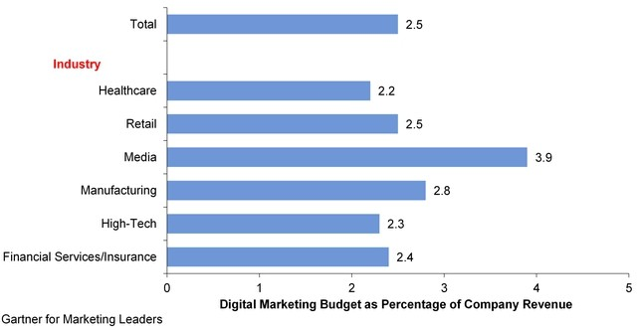
Figure: Digital Marketing Budget as a Percentage of Company Revenue
Data was gathered from responses to the following question: What percentage of your organization's total marketing expense budget is allocated to digital marketing in 2014?
Digital Advertising Accounts for 12.5% of Digital Marketing Budgets
Marketing leaders support a diverse and increasingly complex marketing mix. We asked marketers how much of their digital marketing budget they're allocating to different activities such as mobile marketing or analytics.
Below Figure shows that marketers allocated 12.5% the biggest share of their digital marketing budget to digital advertising. Still, marketers wrestle with digital advertising's effectiveness. Advertising agencies, technology providers and brand advertisers are working to address this concern by improving measurement standards and formats.Content creation and management account for the second largest share of digital marketing budgets. This is driven, in part, by the desire to populate the infinite appetites of inbound marketing channels. Social networks, customer forums, and the blogosphere are examples that drive inbound inquiries or actions. However, you need to create content that delivers the right message to the right person at the right time, regardless of how the dialogue gets started. That means content is equally needed to meet the demands of outbound marketing as well. The enormous pressure to create, manage and distribute content for multiple marketing activities through the right channels will only increase ascustomers use more digital channels for collaboration, researching and acquisition of products and services.
Top priorities for increased budgets in 2014 are commerce experiences, social and mobile marketing, and content creation and management. See "Digital Marketers Escalate Investments to Support Commerce Experiences" to learn why enhancing commerce experiences is a business imperative.

Slide 57
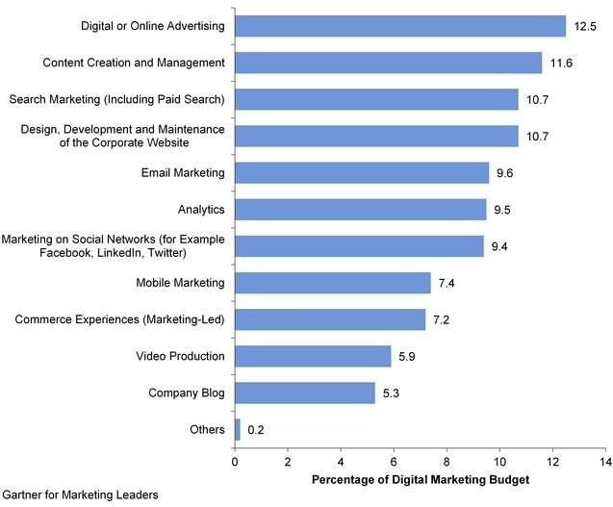
Figure: How Marketers Allocate Their Digital Marketing Budgets
Data was gathered from responses to the following question: How much of the 2014 digital marketing expense budget is your organization spending on each of the activities listed? This includes personnel costs, software and externally purchased services.
48. 41% of Marketers Say That Savings from Digital Marketing Are Reinvested.
We asked marketers to identify how they're funding their digital marketing activities. We found that digital marketing's effectiveness helps stretch digital marketing budgets. Below Figure shows that two in five marketers are realizing savings from digital marketing compared with traditional techniques. And they're
taking that money and reinvesting it into more digital marketing. Fifty-nine percent of the marketers in retail organizations report that this is happening compared with only 28% in manufacturing.
On average, 28% of marketers say they've reduced their traditional advertising budget to fund digital marketing activities. Thirty-four percent of the marketers at high-tech companies are more likely to take this approach compared with only 19% of the marketers at financial services and insurance firms.
Reinvesting savings into digital marketing activities is a smart move. And it's a relatively new activity in a
corporate culture where technology has primarily been used in recent years to cut costs. We don't recommend chasing shiny new objects unreservedly. Rather, we suggest supporting a culture that is agile and keeps an

Slide 58
14. LEARNINGS
Get to know about challenges and opportunities for digital marketing in USA.
Gain basic understanding of SEO, SEM, SMM, ORM, etc.
Fulfilling each and every requirement of client is very important regardless of whether that requirement is small or big.
I learned how to pitch the client while meeting.
I experienced the corporate feeling which gives me a good exposure.
I was able to put in practice what I have learnt in my first year of marketing management curriculum.
Leadership quality, it’s all about the impact you have on other people. You need to have leaders within an organization. Leaders will deal with the customer, project, etc. as a leader.
Healthy Competition forced to do better job the trick is to learn from your competitors quicker than they
can learn from you. Always look for your competitors’ strengths.
Digital marketing work is all about a team work and it always try to give best out of all.
Time management is the big management lesson I have learnt as make individual more divert to words it work.
How to do a formal communication, the way how to communicate with each level of management to get work done.
Every day same task, but the situations are different
It’s not only from my experience, but also from my observation. All colleagues are doing the same type
of work, but the situation is different. Sometime they have problem with a client, but on the next day they problems with vendors or with creative team. While coming to me, my first month was more concentrated with pitch presentation. Industry or clients are different or requirements of the client are different, but contents or the flow of pitch presentations are same.
Observation is the best teacher
There are lots of situations where I am completely blank and I don’t know how to do some task. In those
situations I observed my colleagues to know how they are doing it and I understood the importance of observation.
Work life balancing
This is the most important learning for me. This research thought me how to balance your personal responsibility and professional responsibility together and how to enjoy life even after getting a job. Working in an agency is not an easy task, the person wants to face a lot of stress and challenges. I am the only person in my office leaving early, while comparing with others. Because my colleagues have lots of work, sometime they will leave by late night only. But they are really enjoying all the moments in their life. They don’t have any difference between professional life and personal life.

Slide 59
15. CONCLUSION
The successful completion of this research indicates that the future of marketing is in the hands of digital. Digital marketing is not only concerned with placing ads in portals, it consists of integrated services and integrated channels. Marketers want to use these components in an effective way to reach target groups and to build a brand. In this digital era marketer is not the custodian for a brand, people who are connected across the digital platforms are the custodians.
Brands want to build their presence over digital platform, because customers have high affinity towards digital media than other media’s. More than that customers are highly information seekers and digital media is the only platform for two way communication between brands and customers.
Digital media is the best platform to convert a product to a brand. Because it is more cost effective and it provide lot of touch points to marketer. Brands can able to engage their target group in an effective way through digital platforms. Digital media is not only for engagement, brands can increase their customers or they can retain their existing customers. Digital platforms help to increase the impact of brand recall in target groups.
Importance of digital presence increasing importance of digital agencies, so they making money through digital advertising raising of digital marketing consciousness making money for digital agencies by which they are booming and making more money with small investments.
I honestly believe that this project report will be at most useful for marketers to understand the digital marketing and to plan for future strategies.

Slide 60
16. BIBLIOGRAPHY
www.google.com
www.wikipedia.com
www.informationvine.com

